Slide 1
django
By milan katira

Slide 2
Django start project

Slide 3
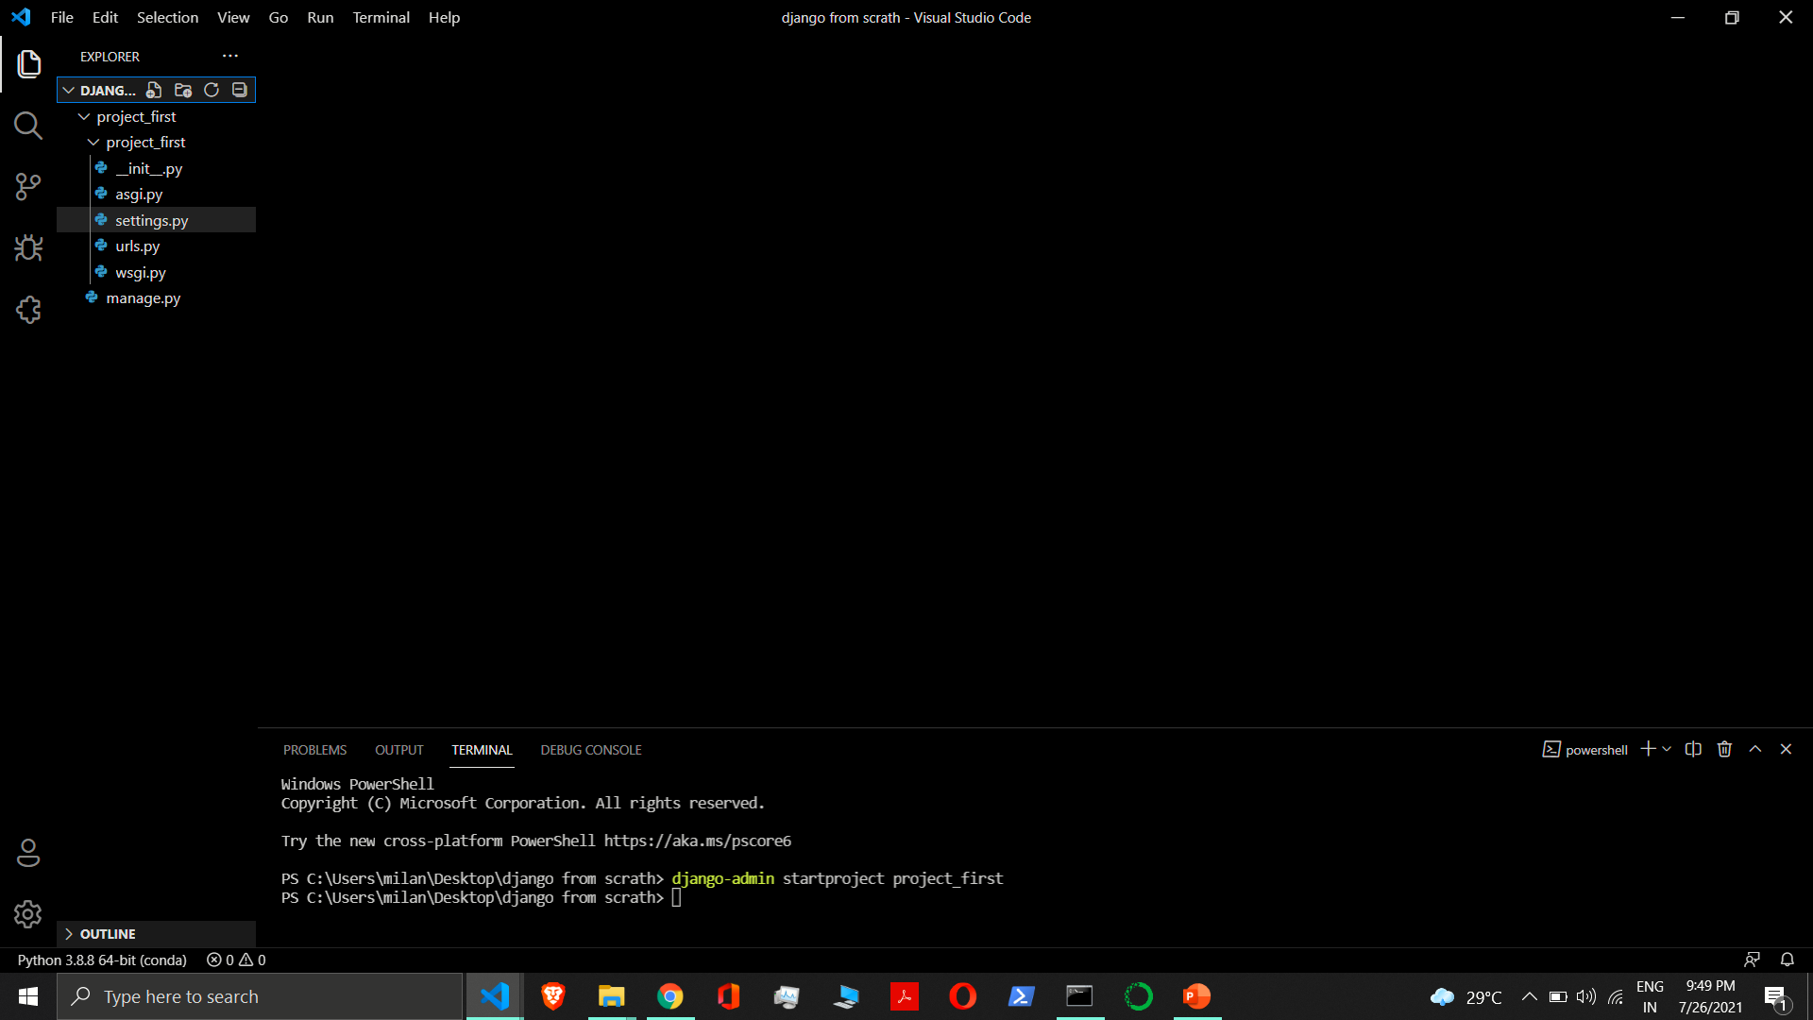

Slide 4
Django app

Slide 5
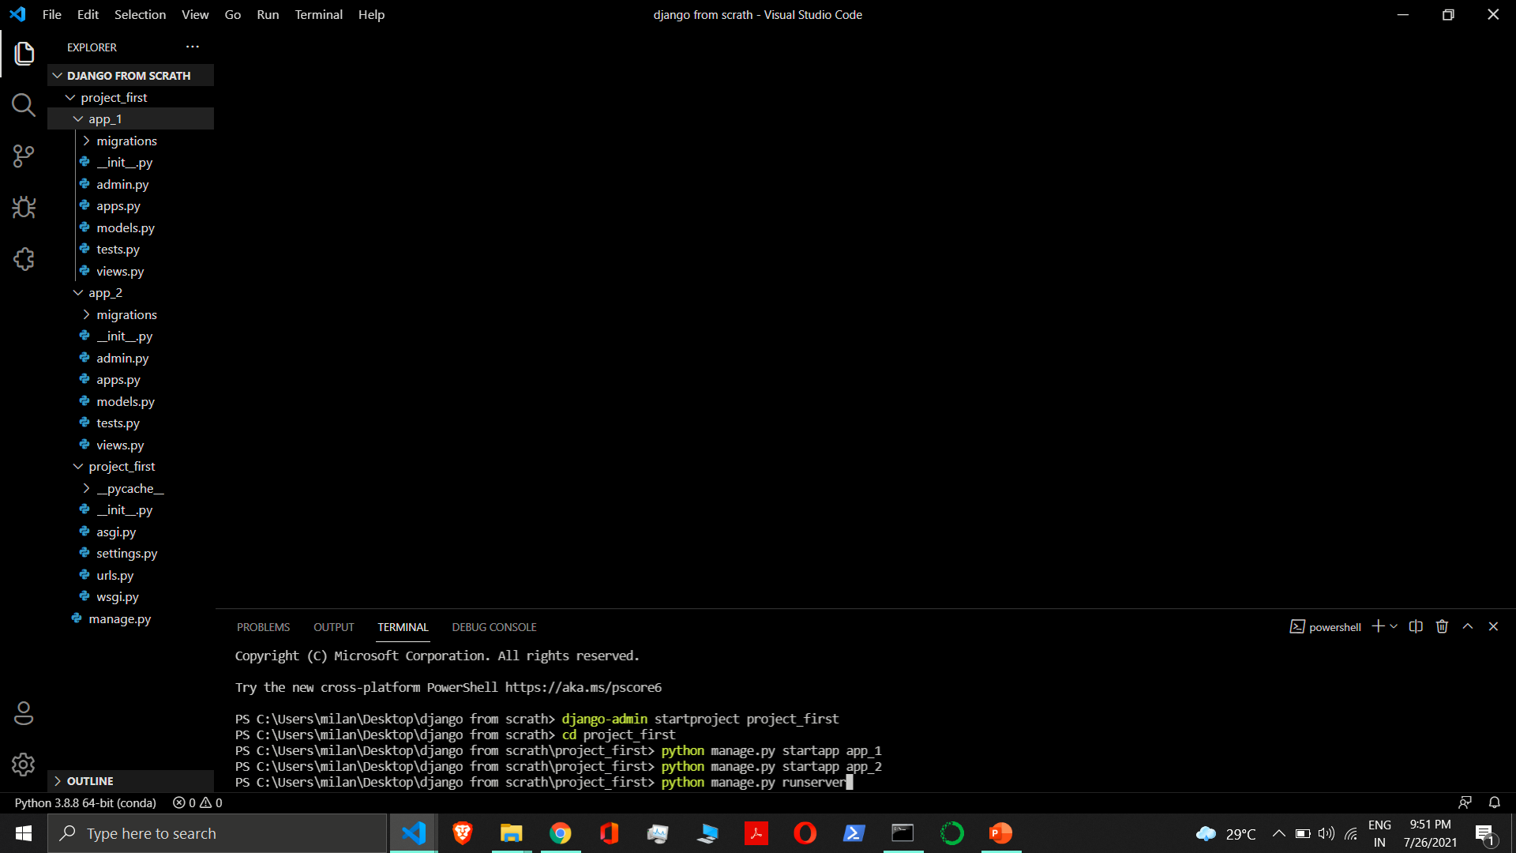

Slide 6
Django project run on a server

Slide 7
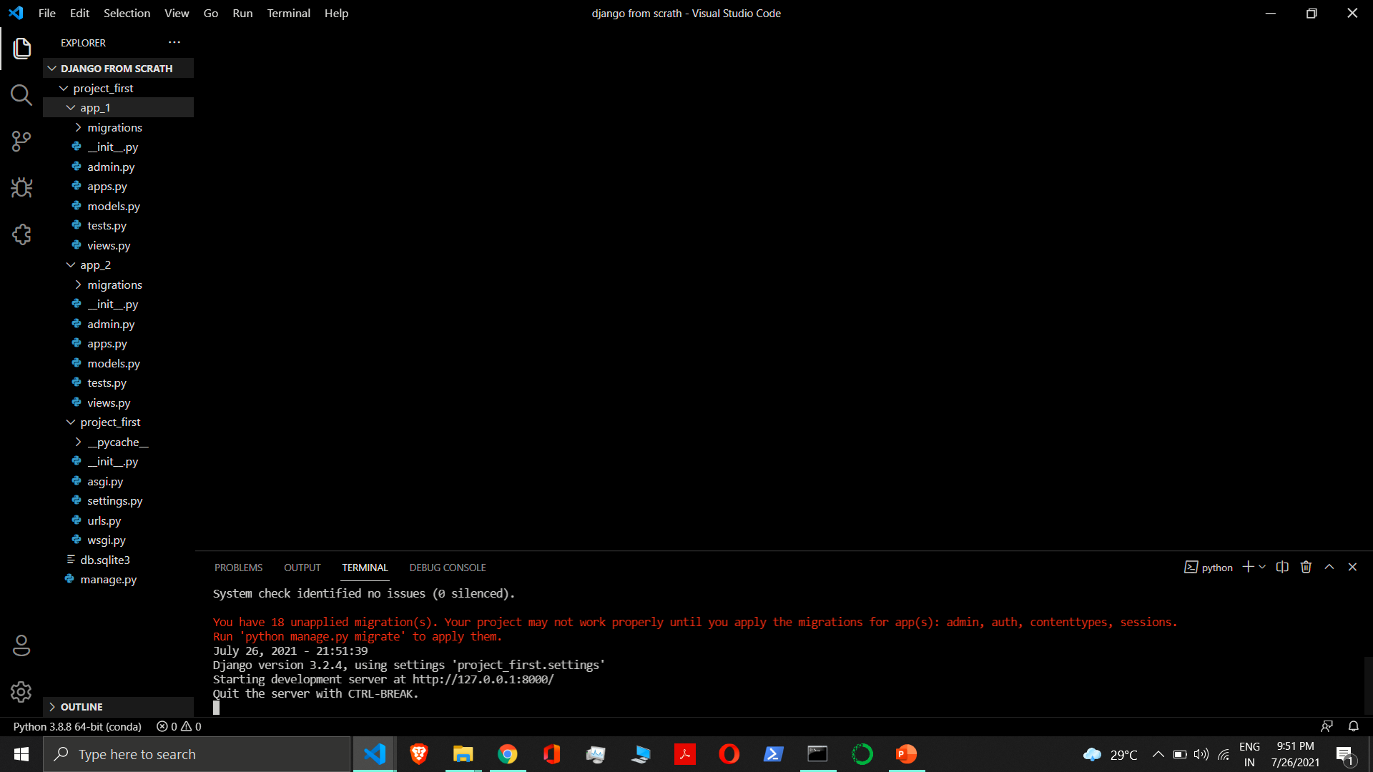

Slide 8
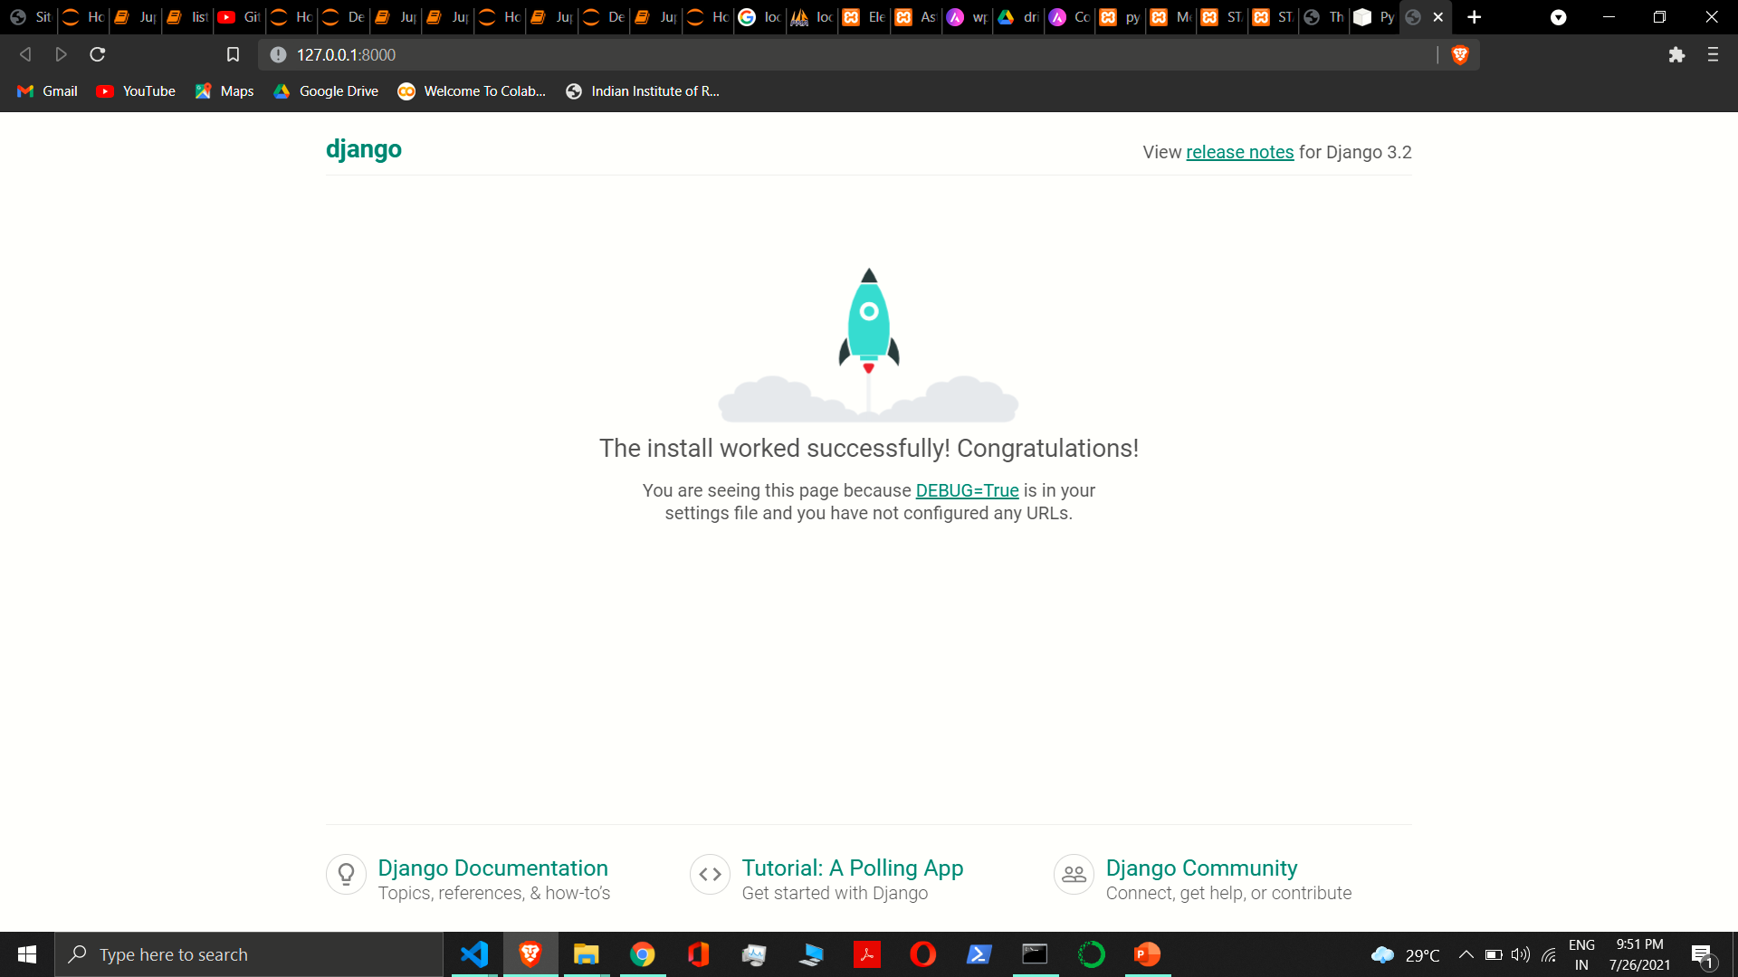

Slide 9
Django project structure
Project_first
/ manage.py
Project_first/
__init__.py
settings.py
urls.py
asgi.py
wsgi.py

Slide 10
Django project file
manage.py: A command-line utility that lets you interact with this Django project in various ways
__init__.py: An empty file that tells Python that this directory should be considered a Python package.
settings.py: Settings/configuration for this Django project.
urls.py: The URL declarations for this Django project; a “table of contents” of your Django-powered site.
asgi.py: An entry-point for ASGI-compatible web servers to serve your project.
wsgi.py: An entry-point for WSGI-compatible web servers to serve your project.

Slide 11
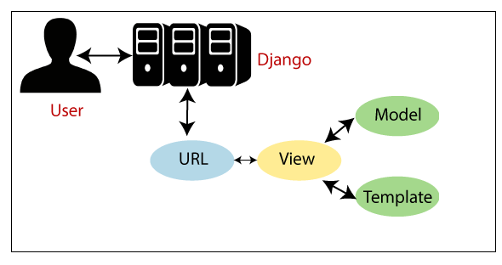
Django mvt architecture

Slide 12
Django mvt architecture
Model
View
Templates
Here, a user requests for a resource to the Django, Django works as a controller and check to the available resource in URL.
If URL maps, a view is called that interact with model and template, it renders a template.
Django responds back to the user and sends a template as a response.

Slide 13
views
Model
Views
Templates

Slide 14
Types of views
Function based views
Class based views

Slide 15
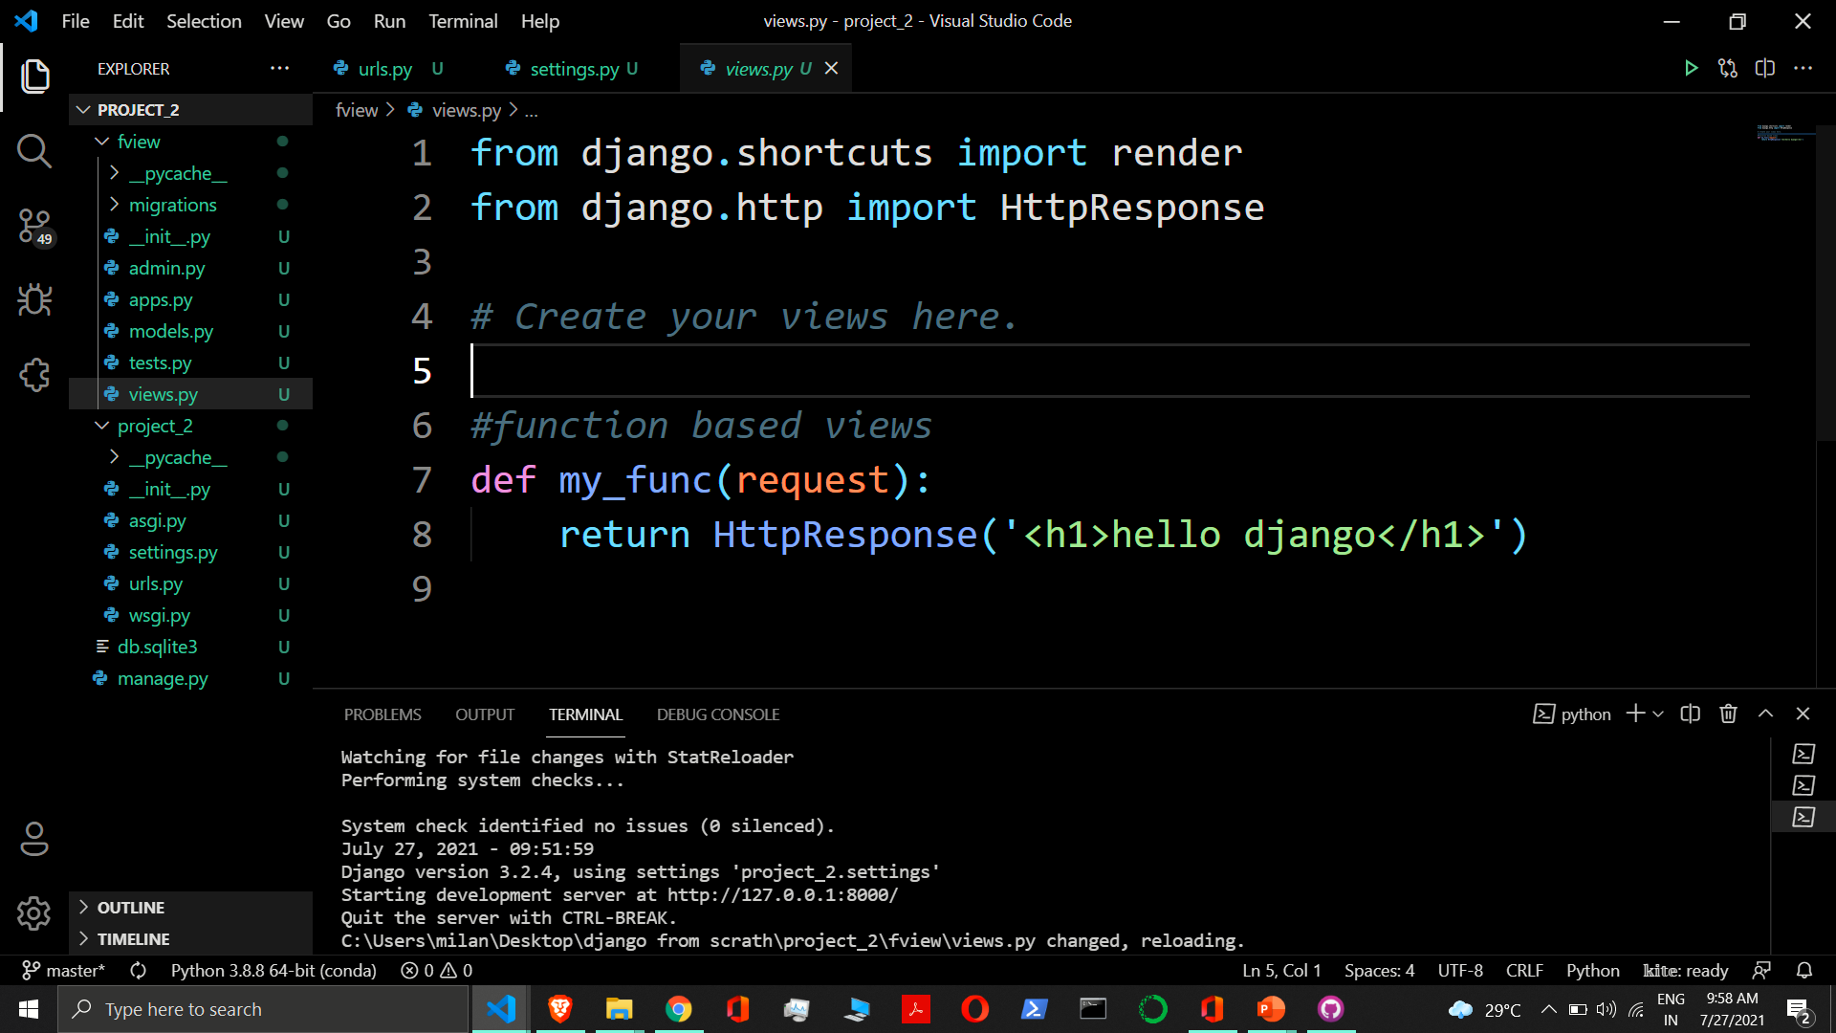
Function based views
It takes request
It return
httpresponse
It return http format response

Slide 16
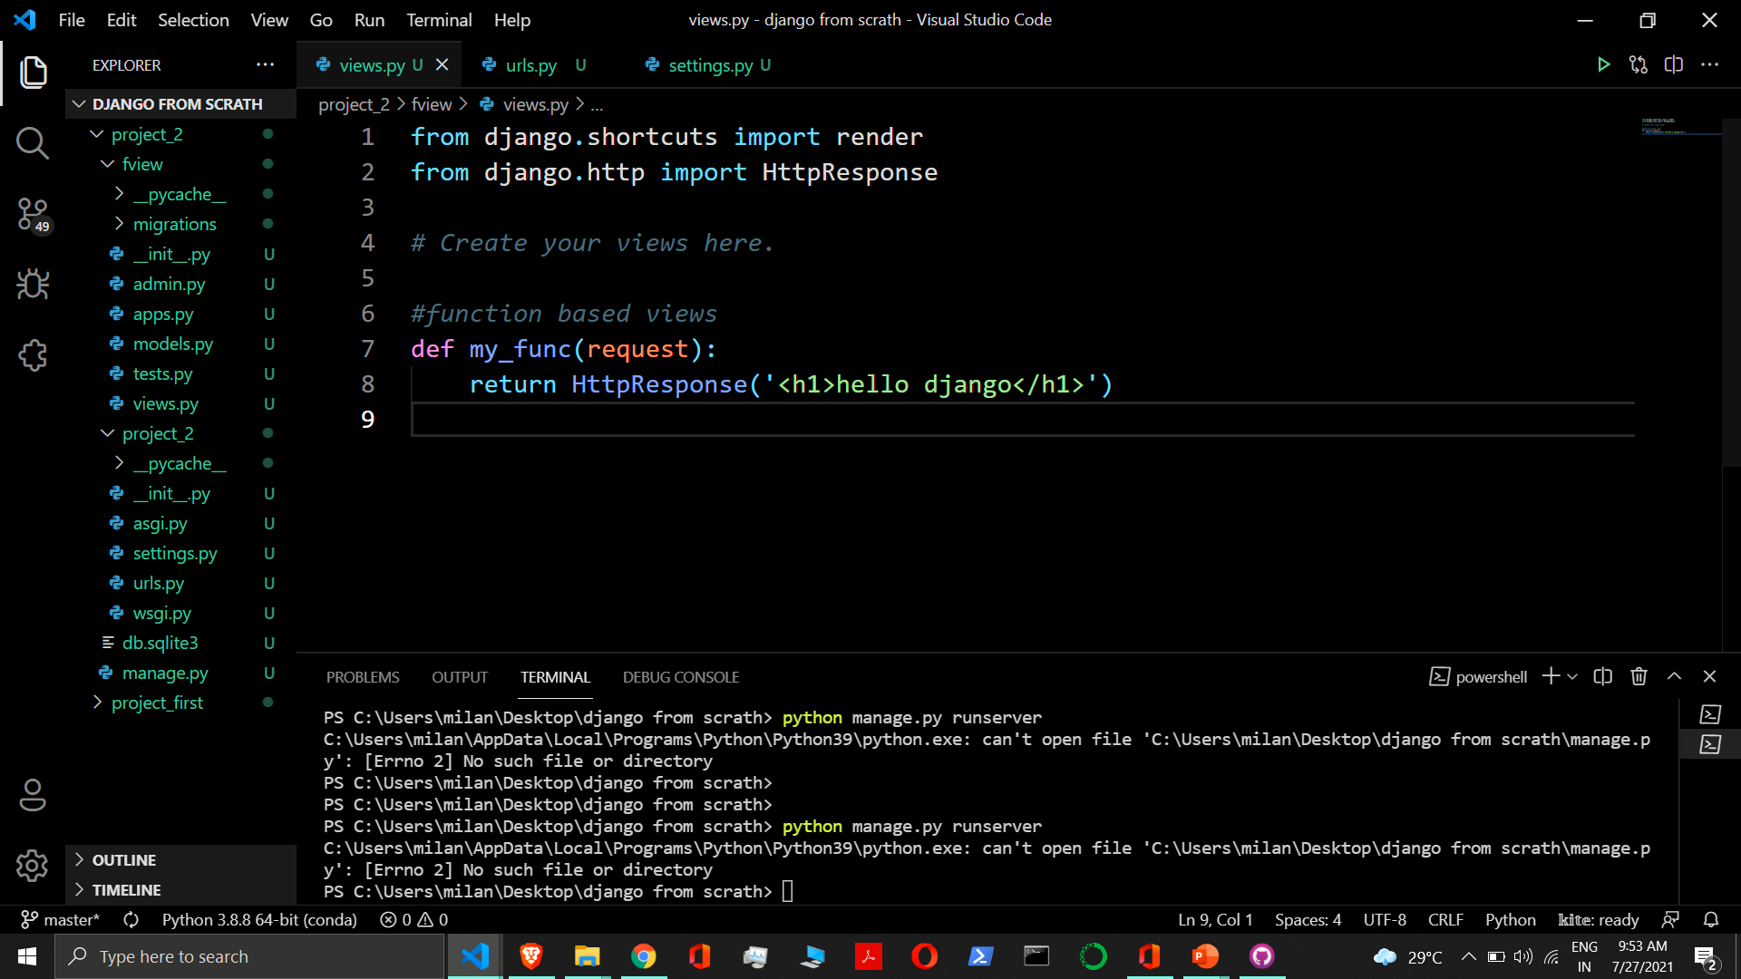

Slide 17
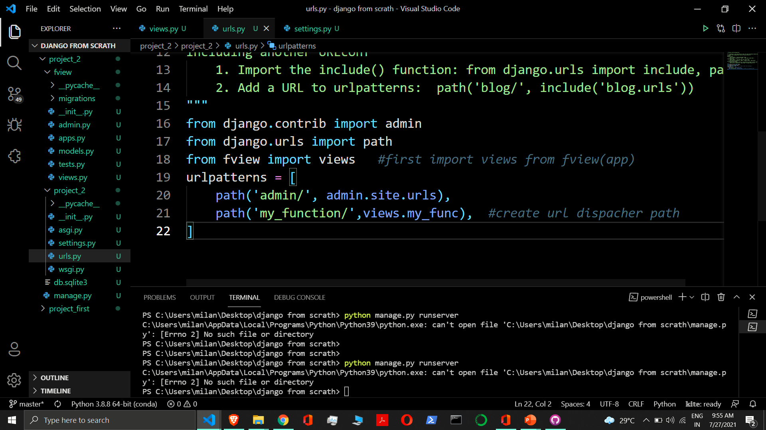

Slide 18
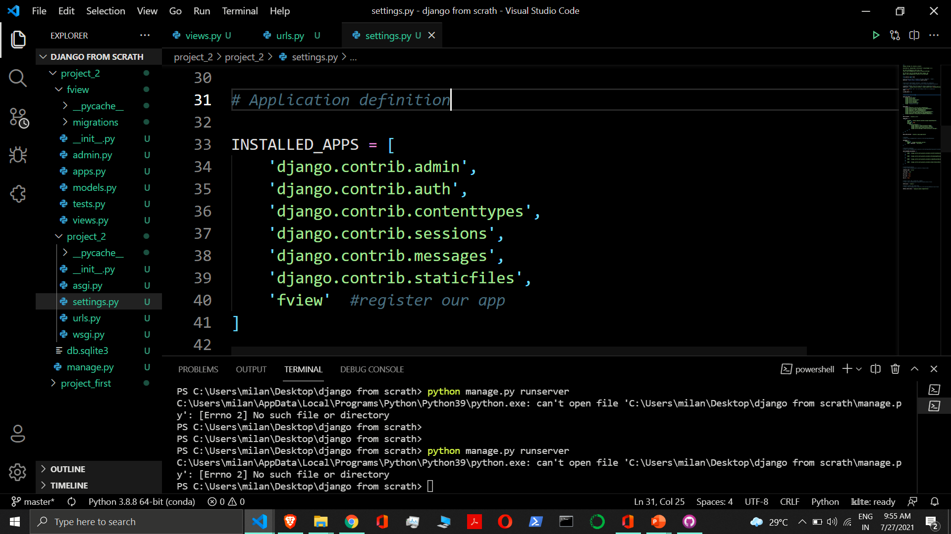

Slide 19
url pattern
There are multiple method to url dispacher

Slide 20
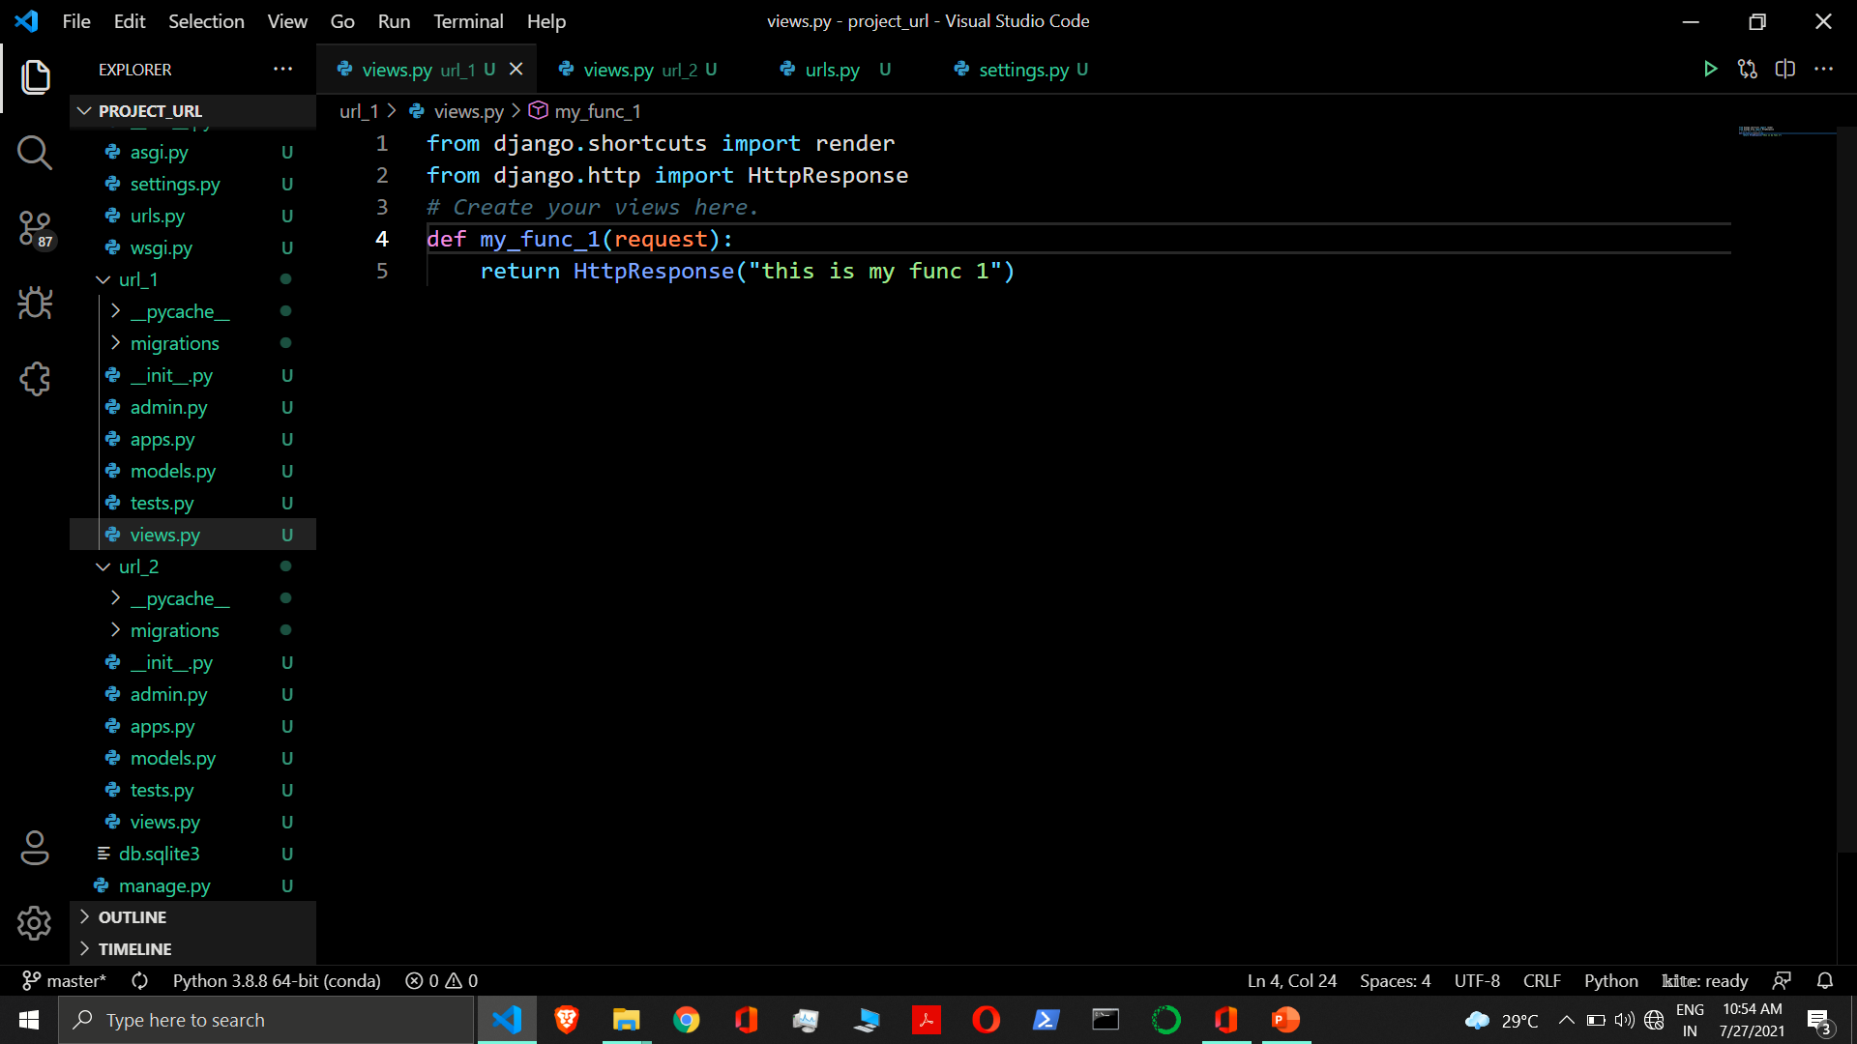

Slide 21
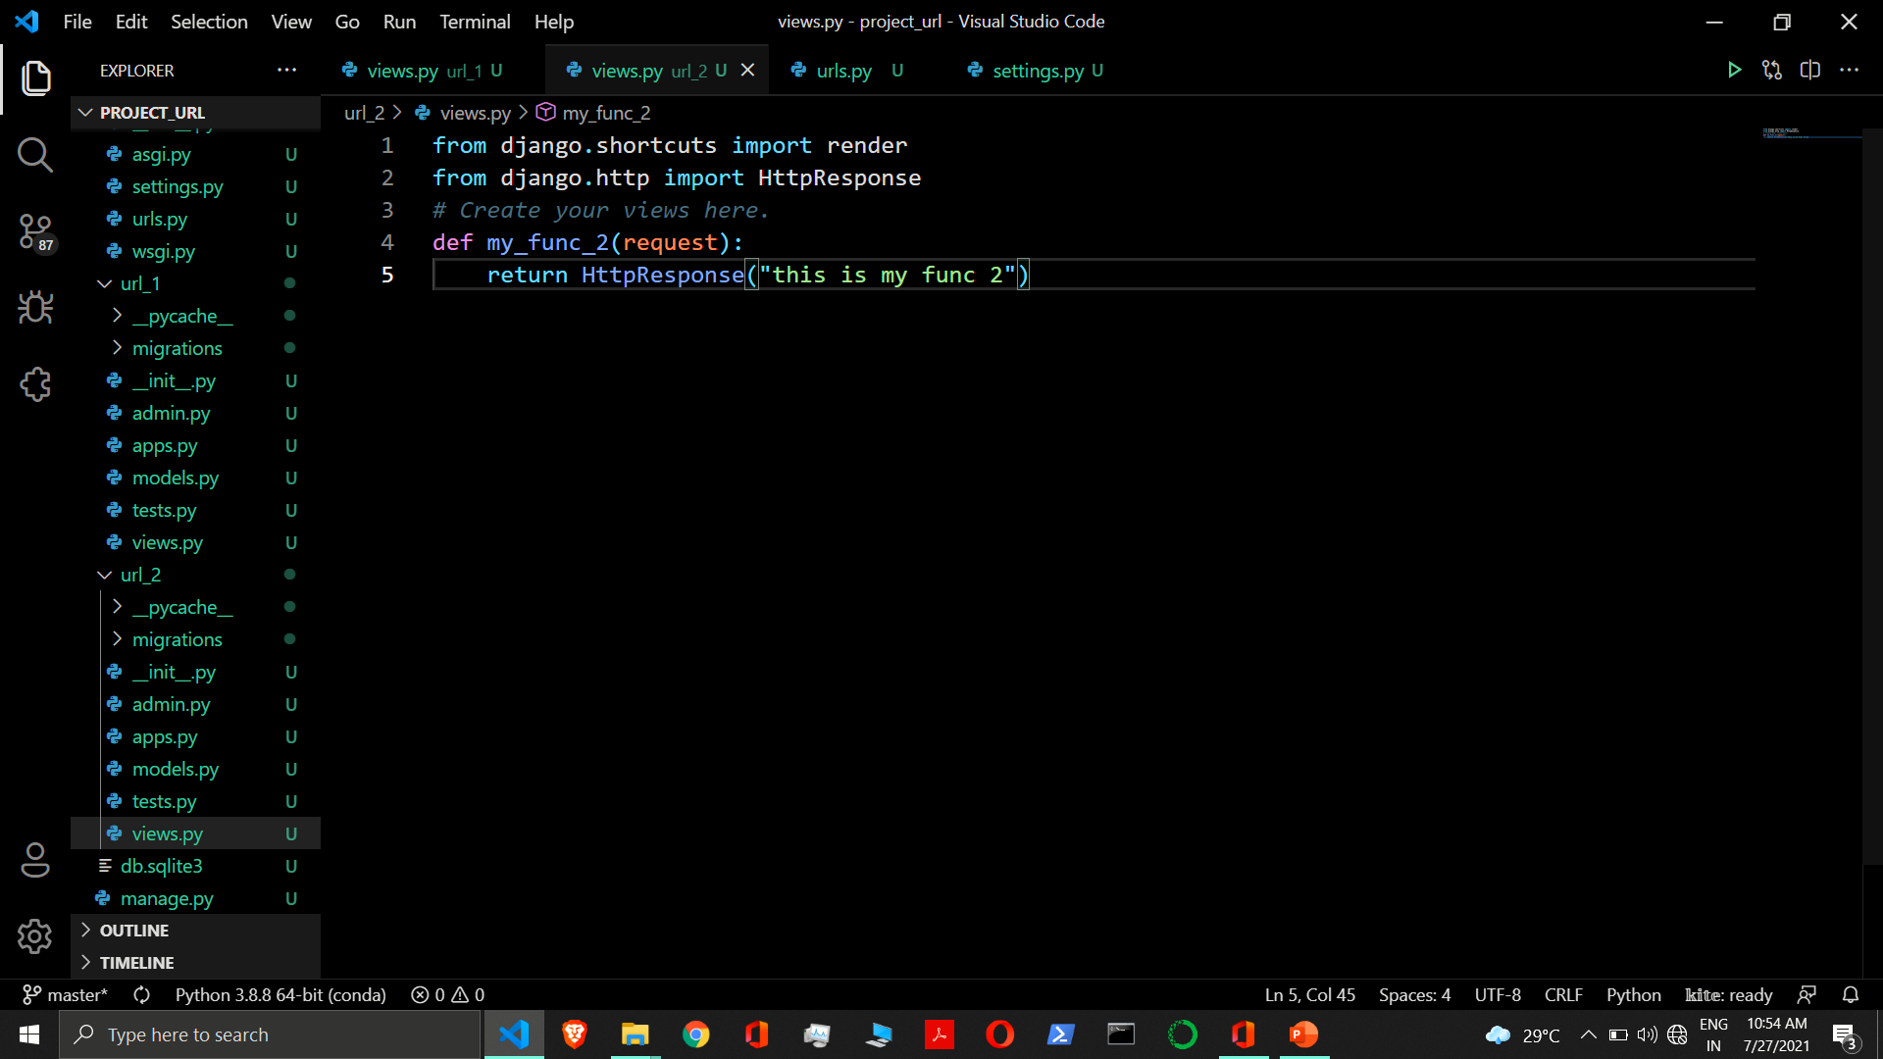

Slide 22
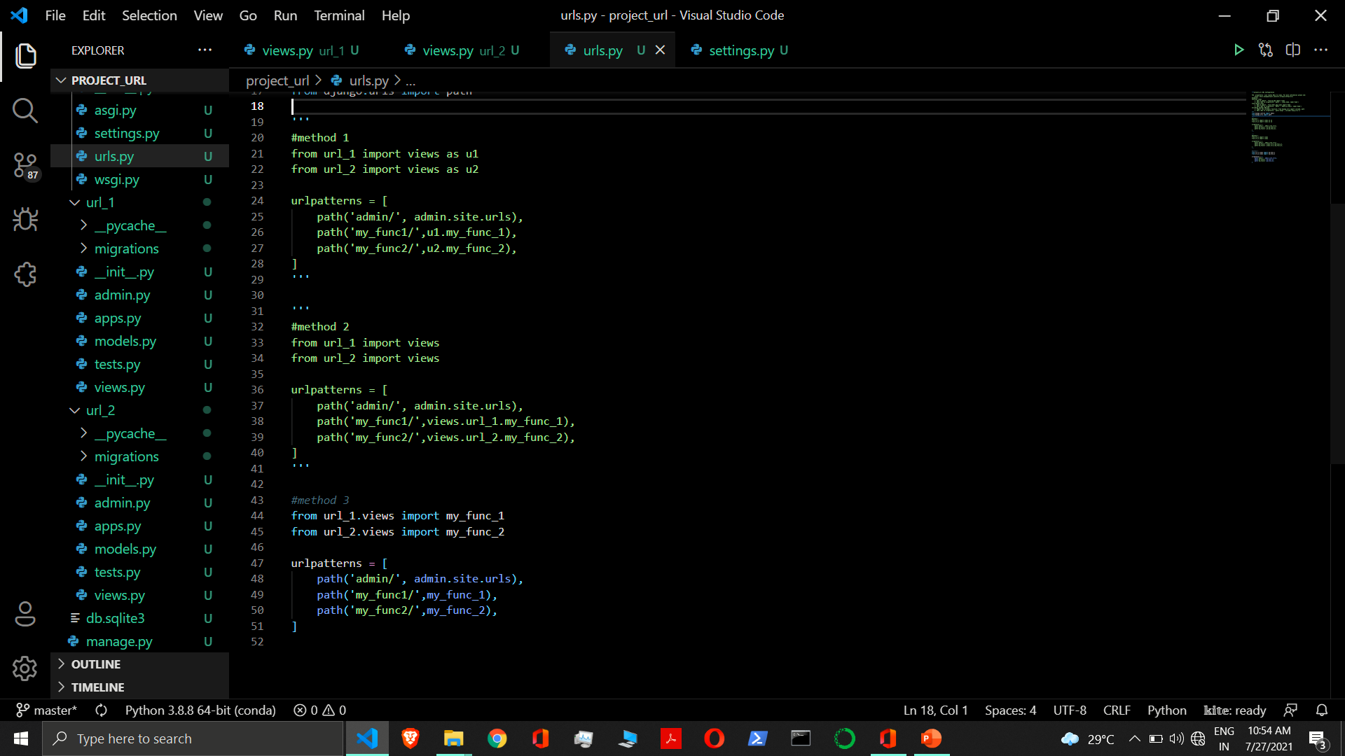

Slide 23
url pattern inside application
With include

Slide 24
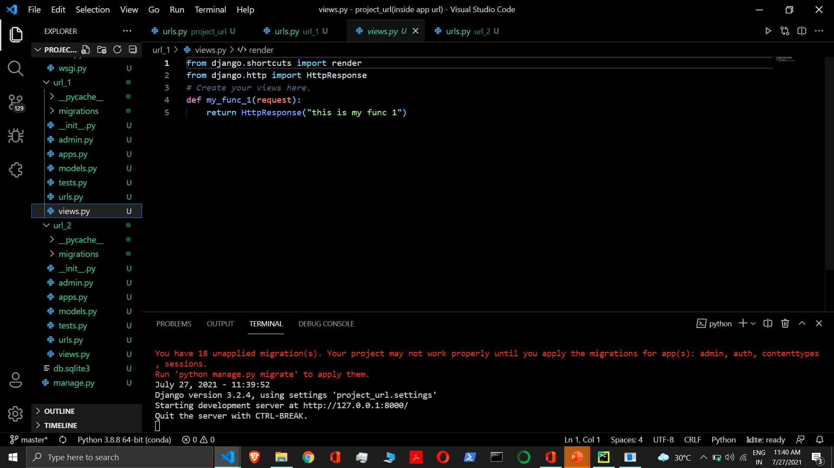

Slide 25
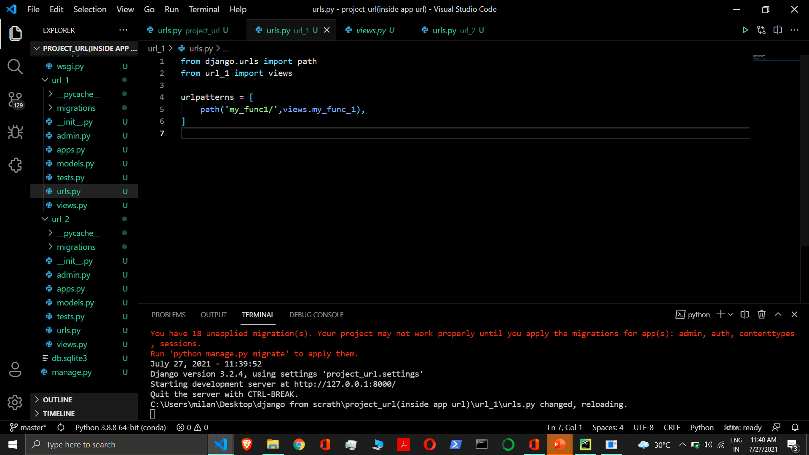

Slide 26
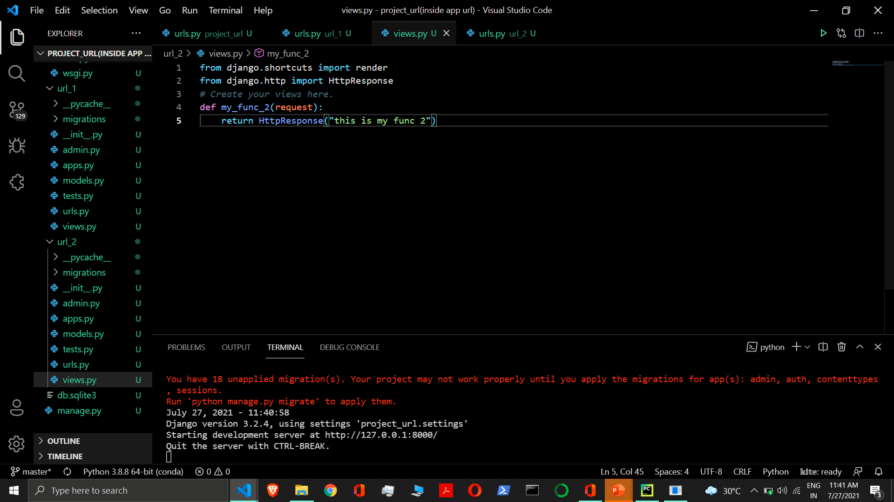

Slide 27
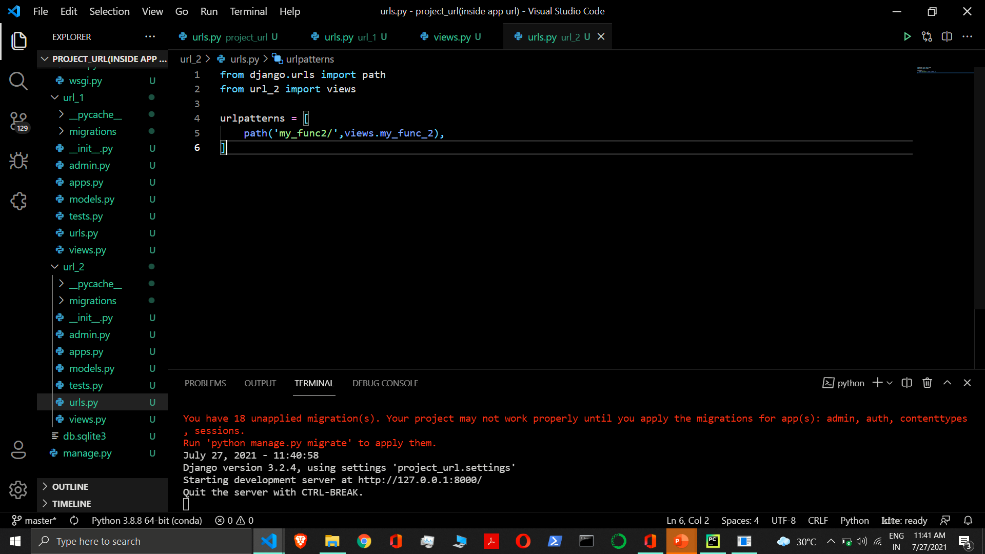

Slide 28
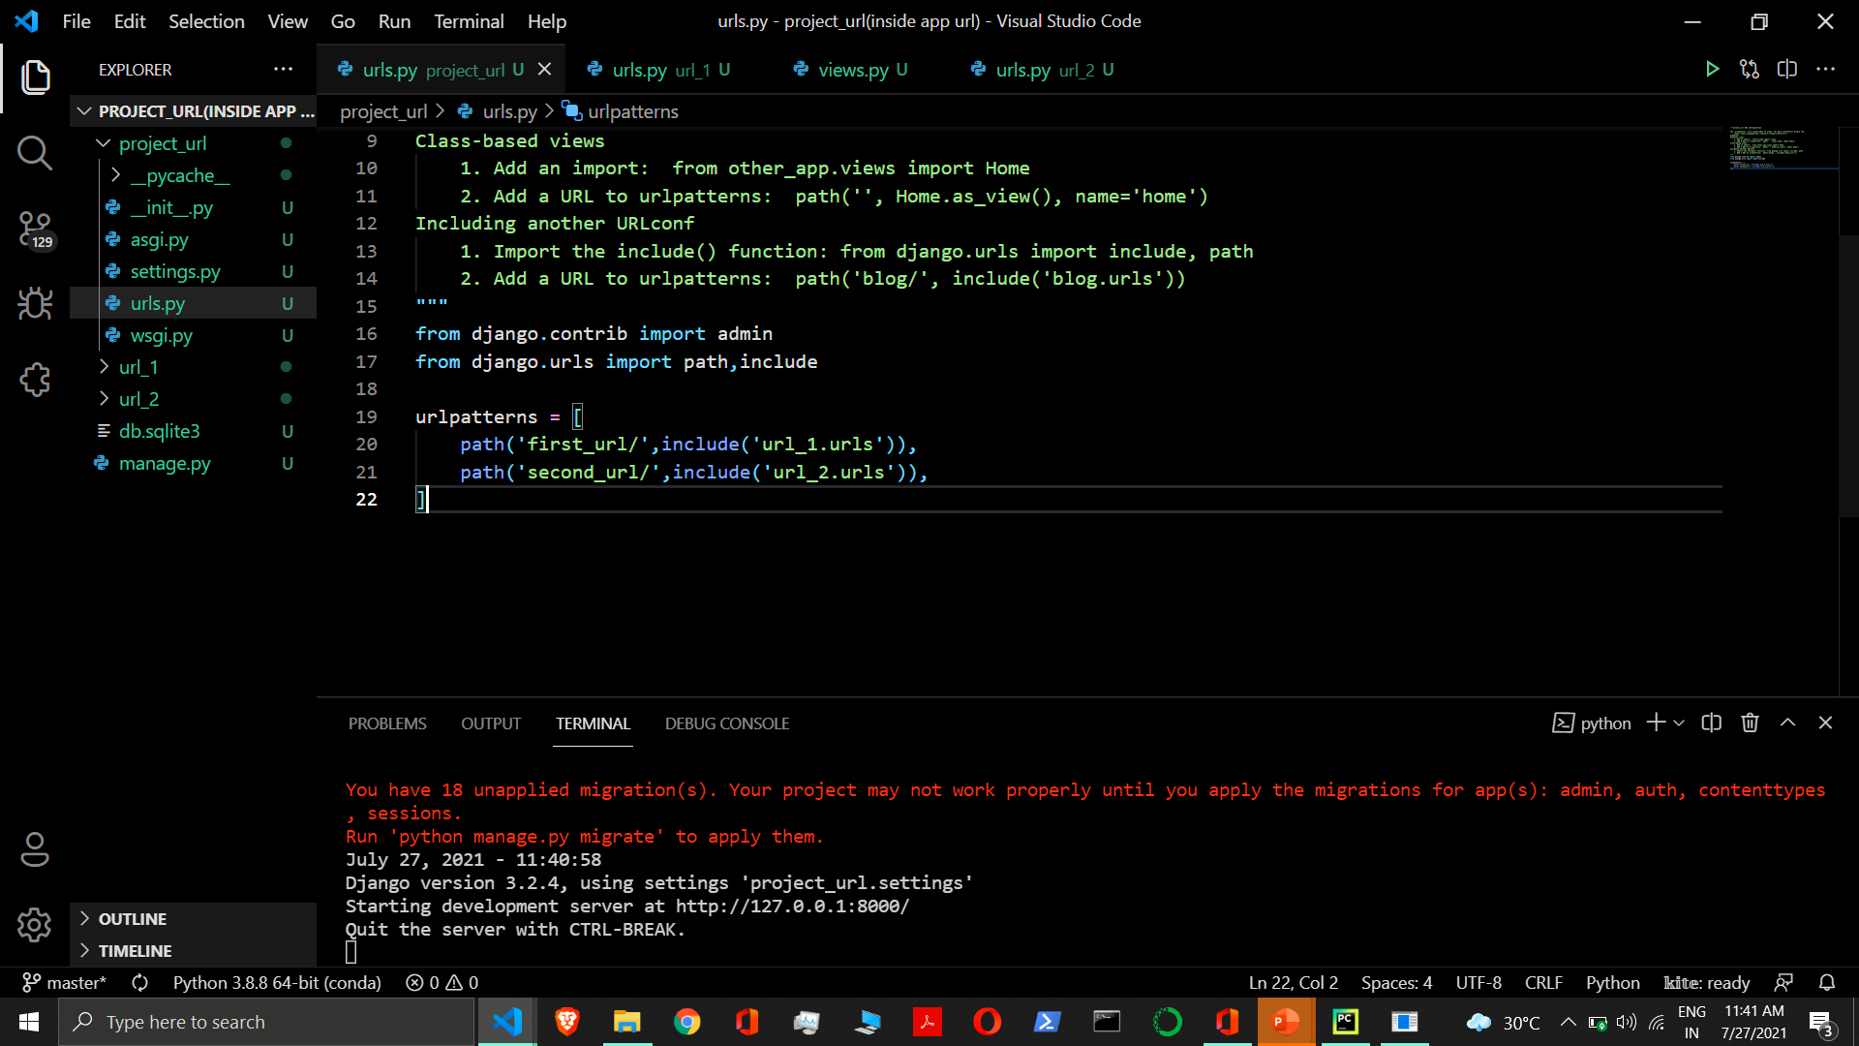

Slide 29
Django templates language

Slide 30
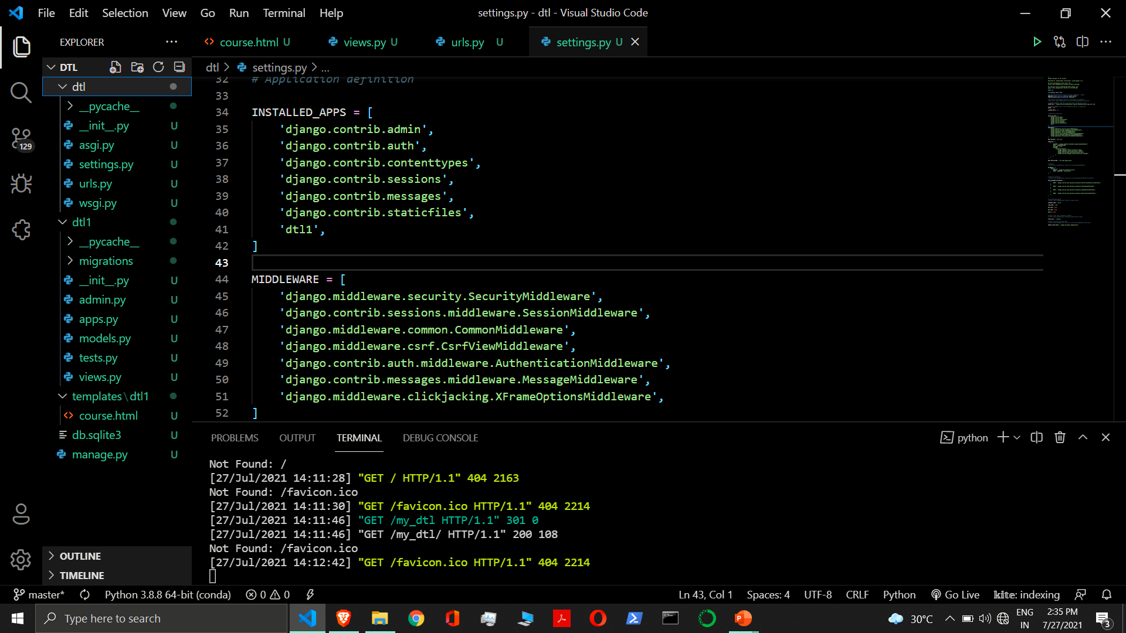

Slide 31
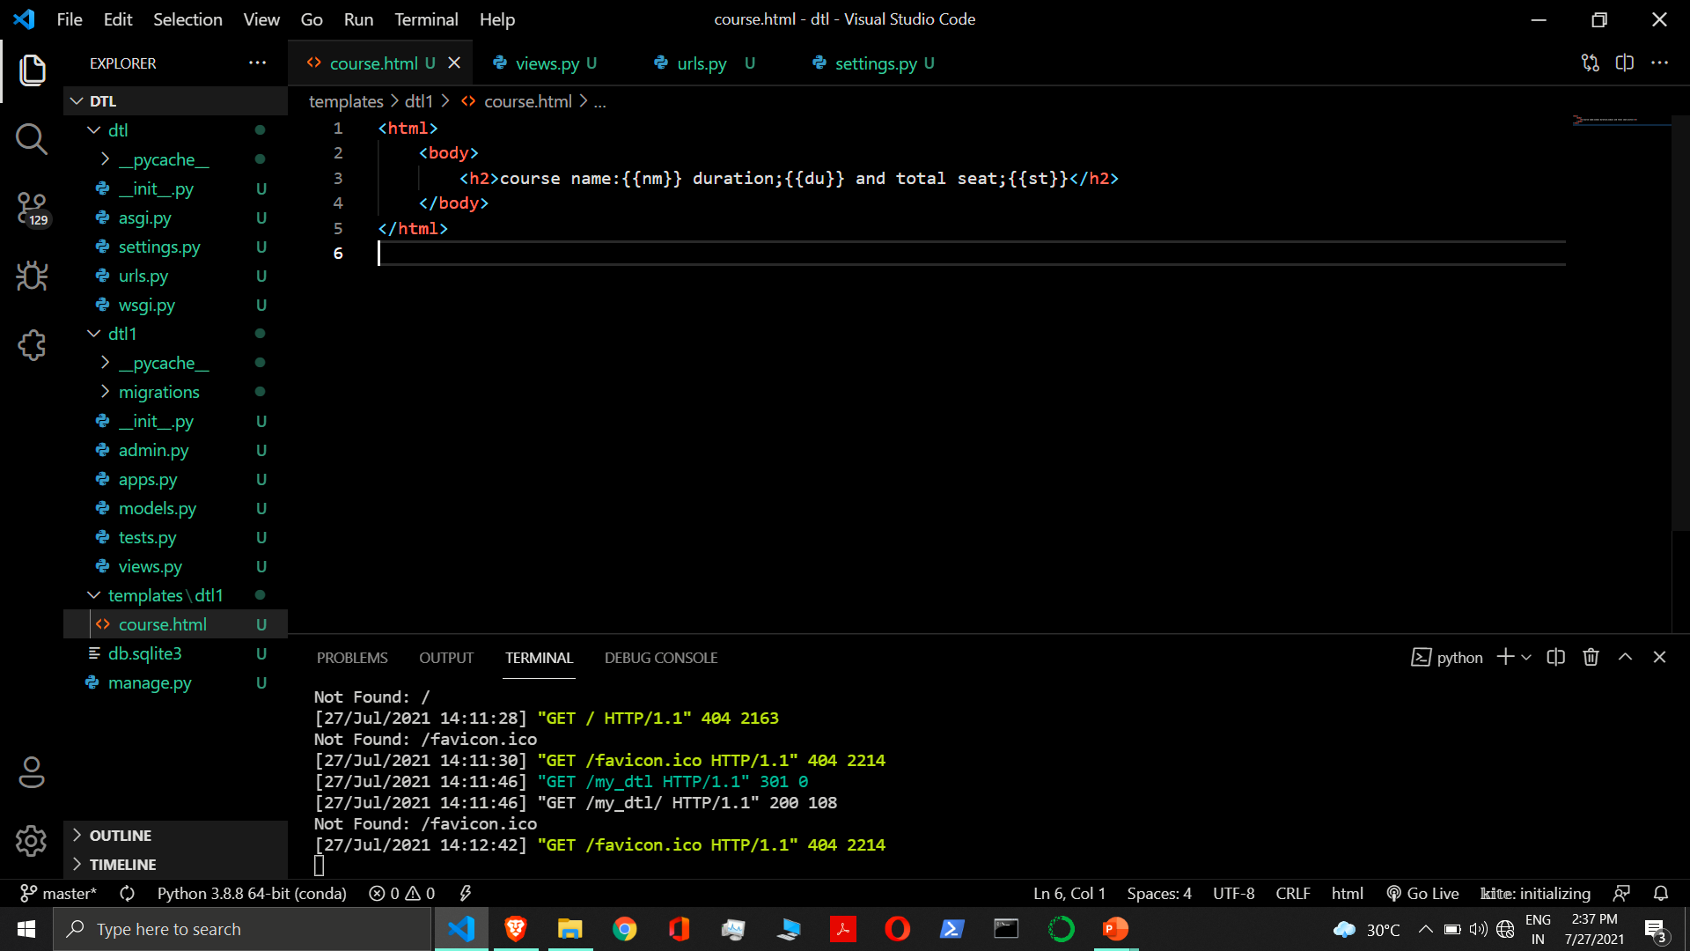

Slide 32
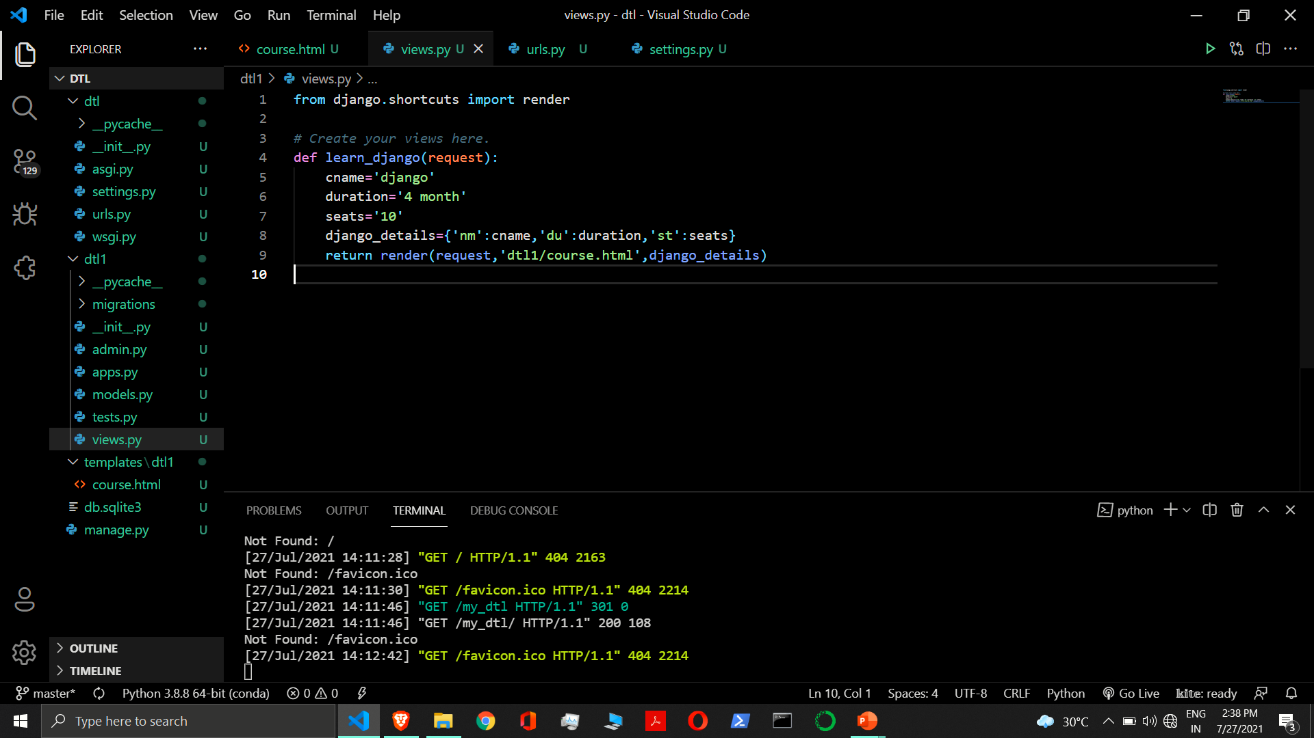

Slide 33
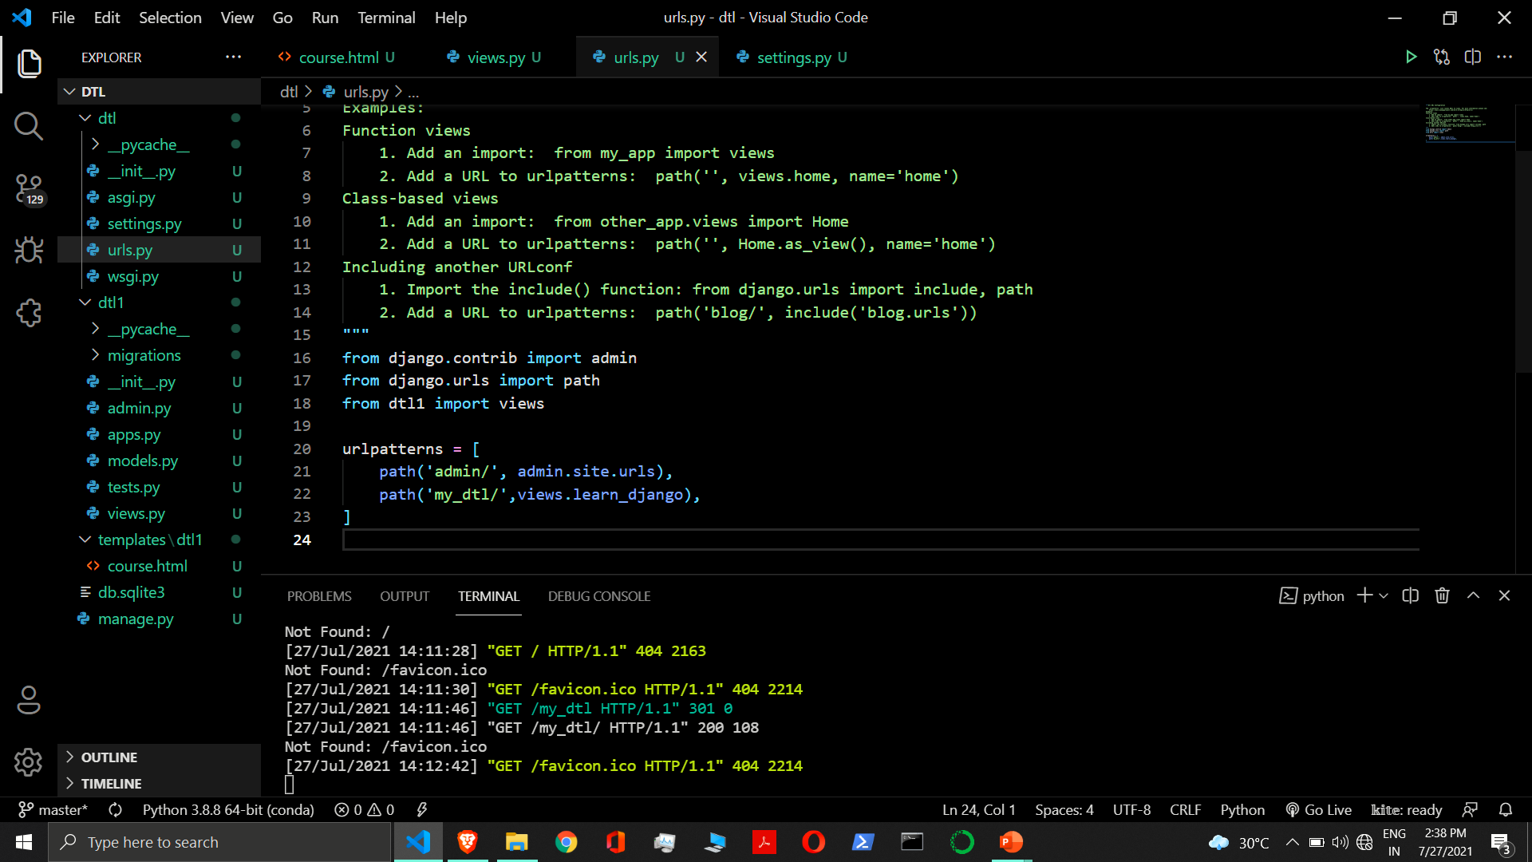

Slide 34
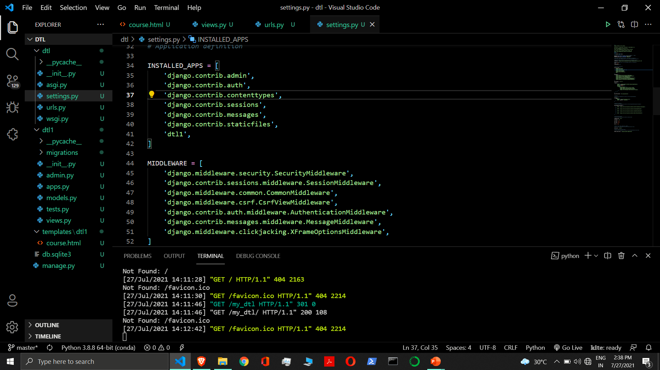

Slide 35
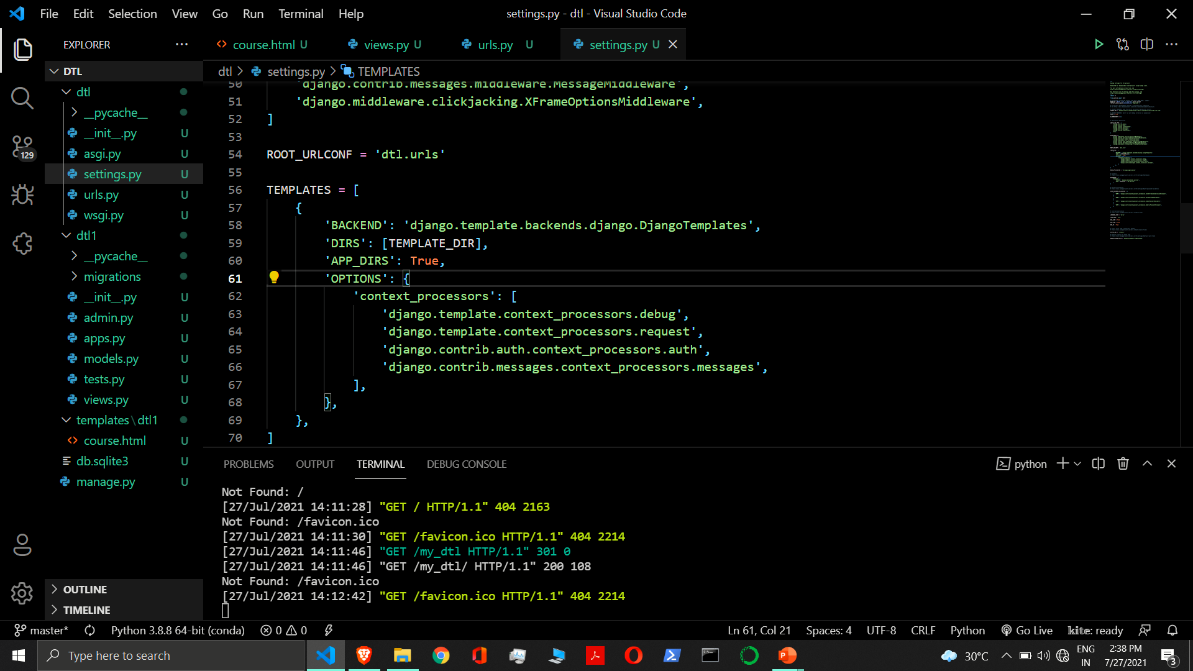

Slide 36
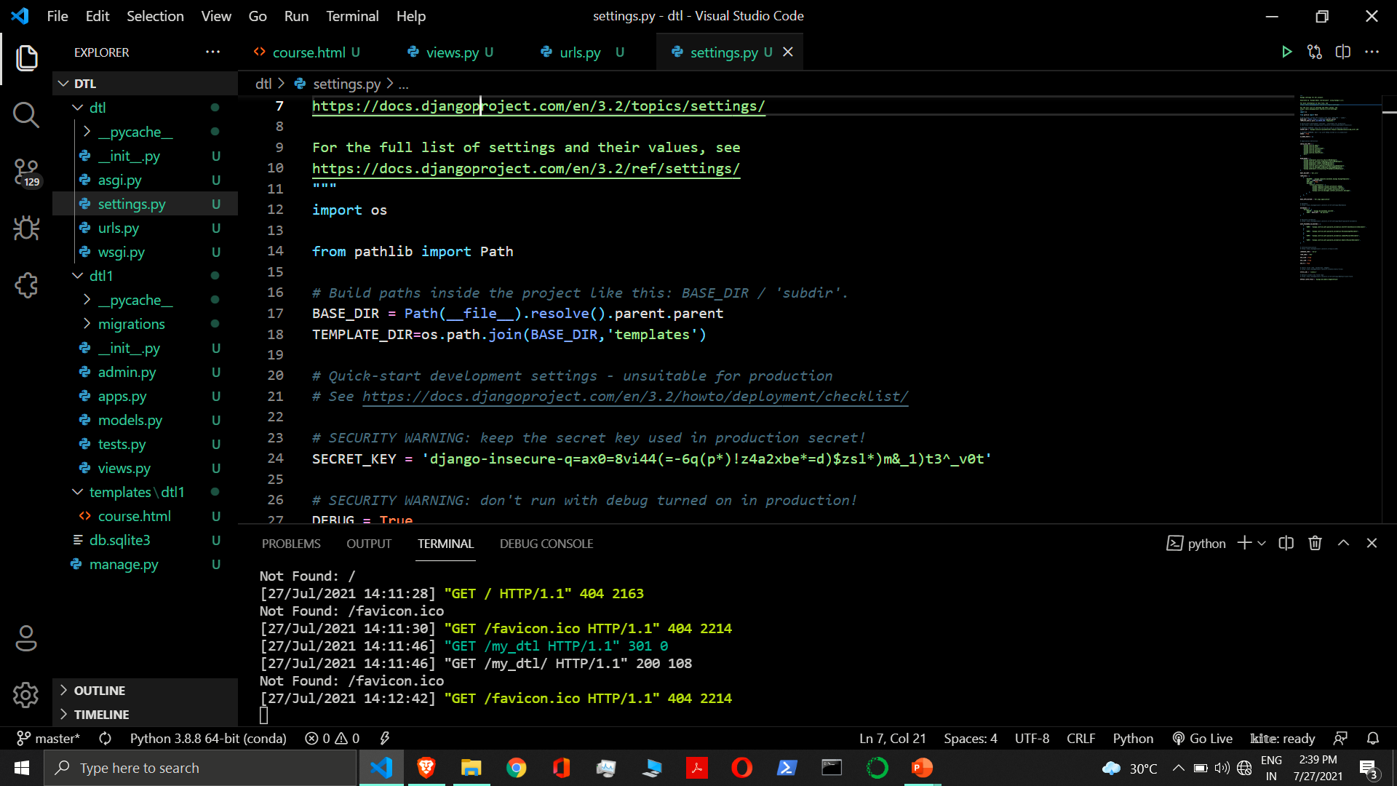

Slide 37
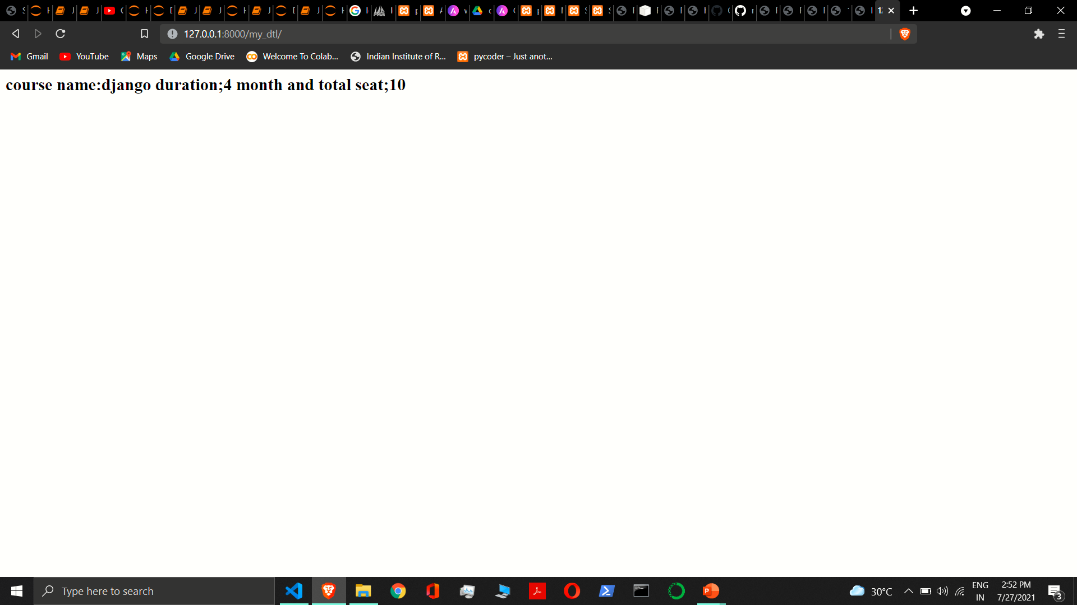

Slide 38
Filters in django
When we need to modify variable before displaying we can use filters. Pipe ‘|’ is used to apply filter.
Syntax:- {{variable | filter}}
Example:- {{name|upper}}
Some of filters take arguments.
Syntax:- {{variable | filter : argument}}
Example:- {{article|truncateword:40}}
Filter can be chained.
Syntax:- {{variable | filter | filter}}
Example:- {{article|upper}}
Example:- {{article|upper|truncateword:40}}

Slide 39
Filters in django
capfirst – It capitalizes the first character of the value. If the first character is not a letter, this filter has no effect.
Example:- {{value|capfirst}}
default - If value evaluates to False, uses the given default. Otherwise, uses the value.
Example:- {{ value|default:"nothing" }}
If value is "" (the empty string), the output will be nothing.
length - It returns the length of the value. This works for both strings and lists. The filter returns 0 for an undefined variable.
Example:- {{ value|length }}
lower - It converts a string into all lowercase.
Example:- {{ value|lower }}

Slide 40
Filters in django
upper - It converts a string into all uppercase.
Example:- {{ value|upper }}
slice - It returns a slice of the list. Uses the same syntax as Python’s list slicing.
Example:- {{ some_list|slice:":2" }}
truncatechars - It truncates a string if it is longer than the specified number of characters. Truncated strings will end with a translatable ellipsis character (“…”).
Argument: Number of characters to truncate to
Example:- {{ value|truncatechars:7 }}
truncatewords - It truncates a string after a certain number of words. Newlines within the string will be removed.
Argument: Number of words to truncate after
Example:- {{ value|truncatewords:2 }}

Slide 41
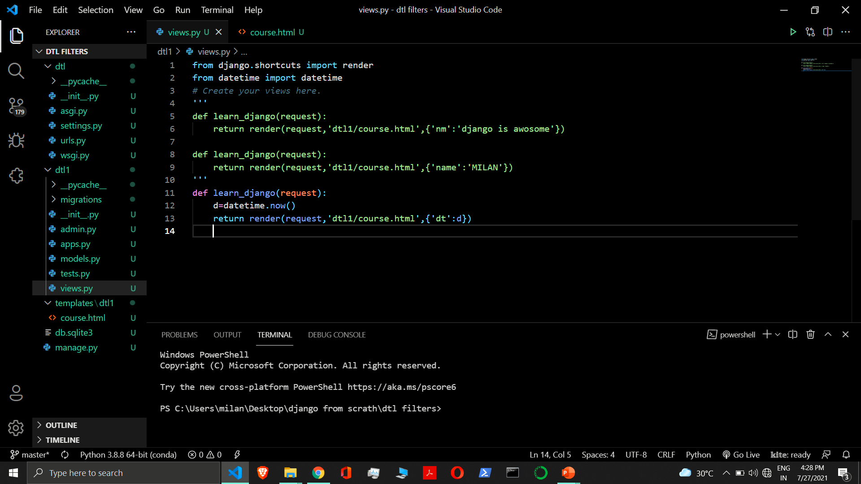

Slide 42
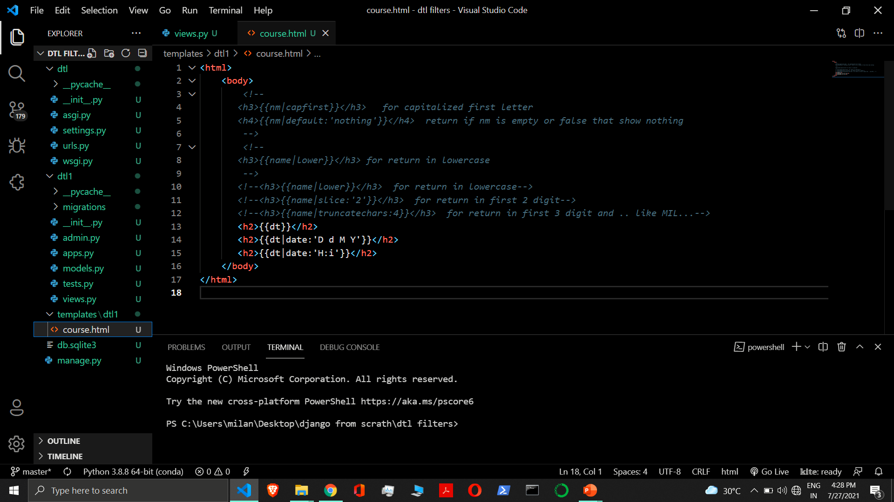

Slide 43
Filter in django
date – It formats a date according to the given format.
Example:- {{value|date:“D d M Y”}}
time – It formats a time according to the given format.
Example:- {{value|time:“H:i”}}

Slide 44
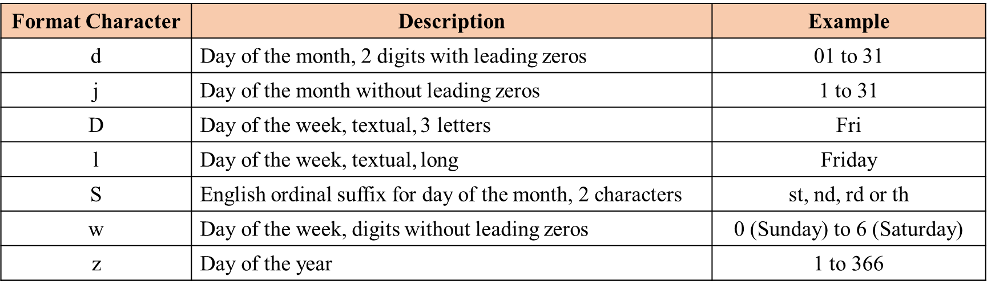
Date filter

Slide 45
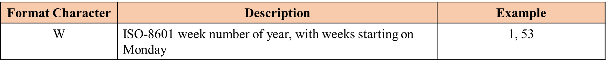
week filter

Slide 46
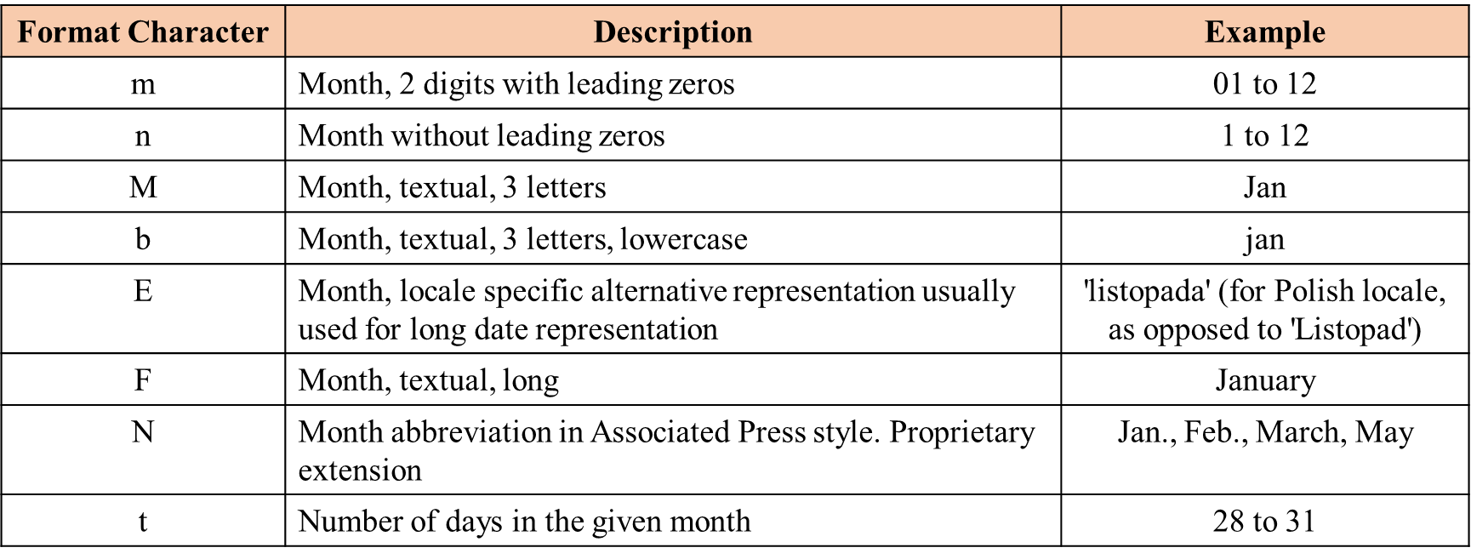
month filter

Slide 47
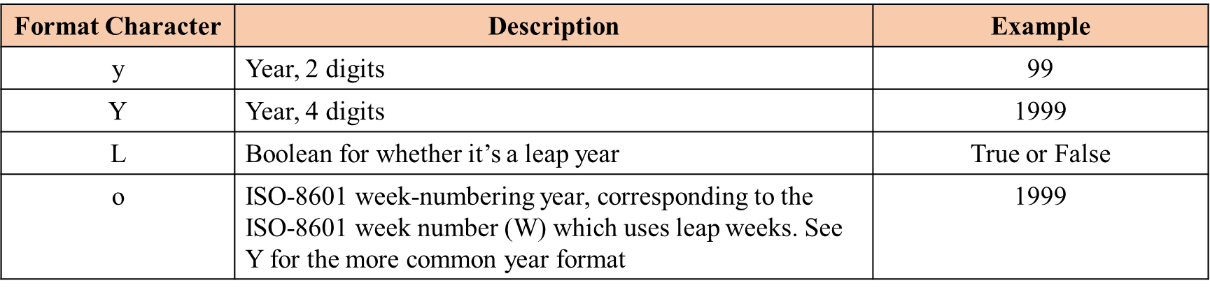
year filter

Slide 48
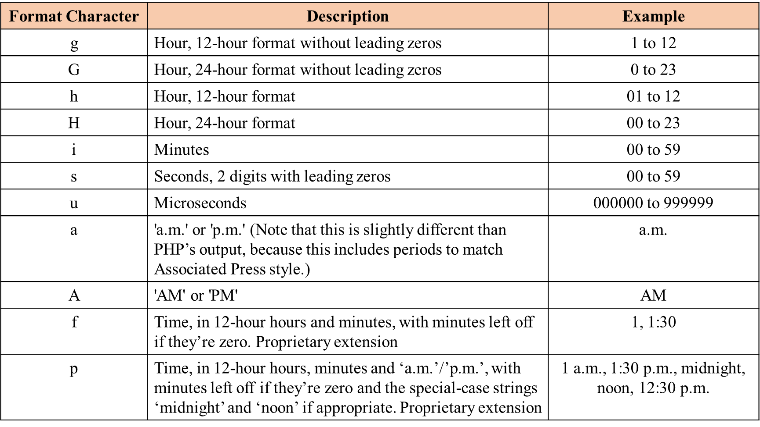
time filter

Slide 49
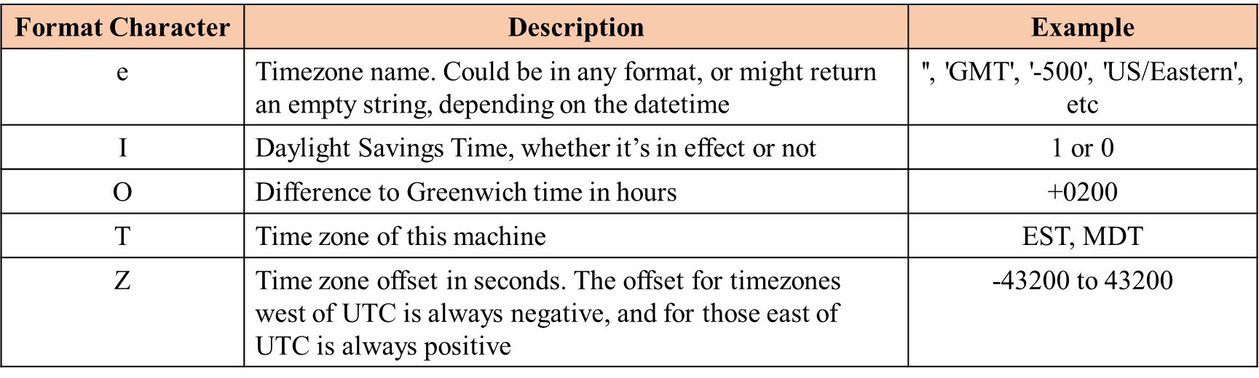
timezone filter

Slide 50
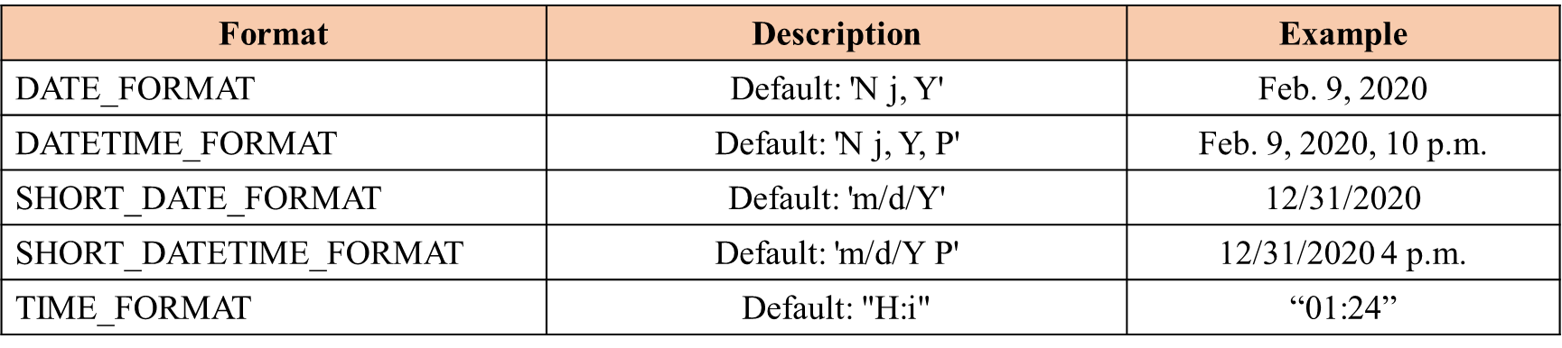
Predifine format

Slide 51
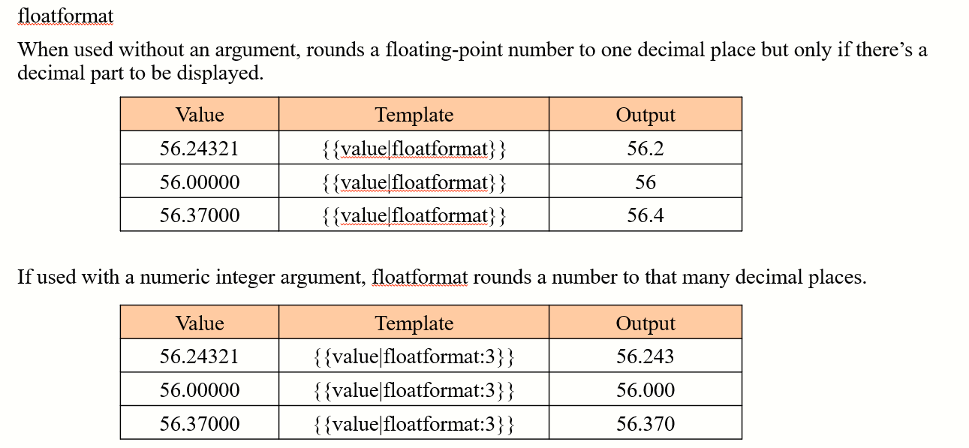
Float filter

Slide 52
If Tag in django
{% if %} tag - The {% if %} tag evaluates a variable, and if that variable is “true” (i.e. exists, is not empty, and is not a false boolean value).
Syntax:-
{% if variable %}
…………..
{% endif %}

Slide 53
Else Tag in django
{% if variable %}
…………..
{% else %}
…………..
{% endif %}

Slide 54
For loop Tag in django
{% for variable in variables %}
{{ variable }}
{% endfor %}

Slide 55
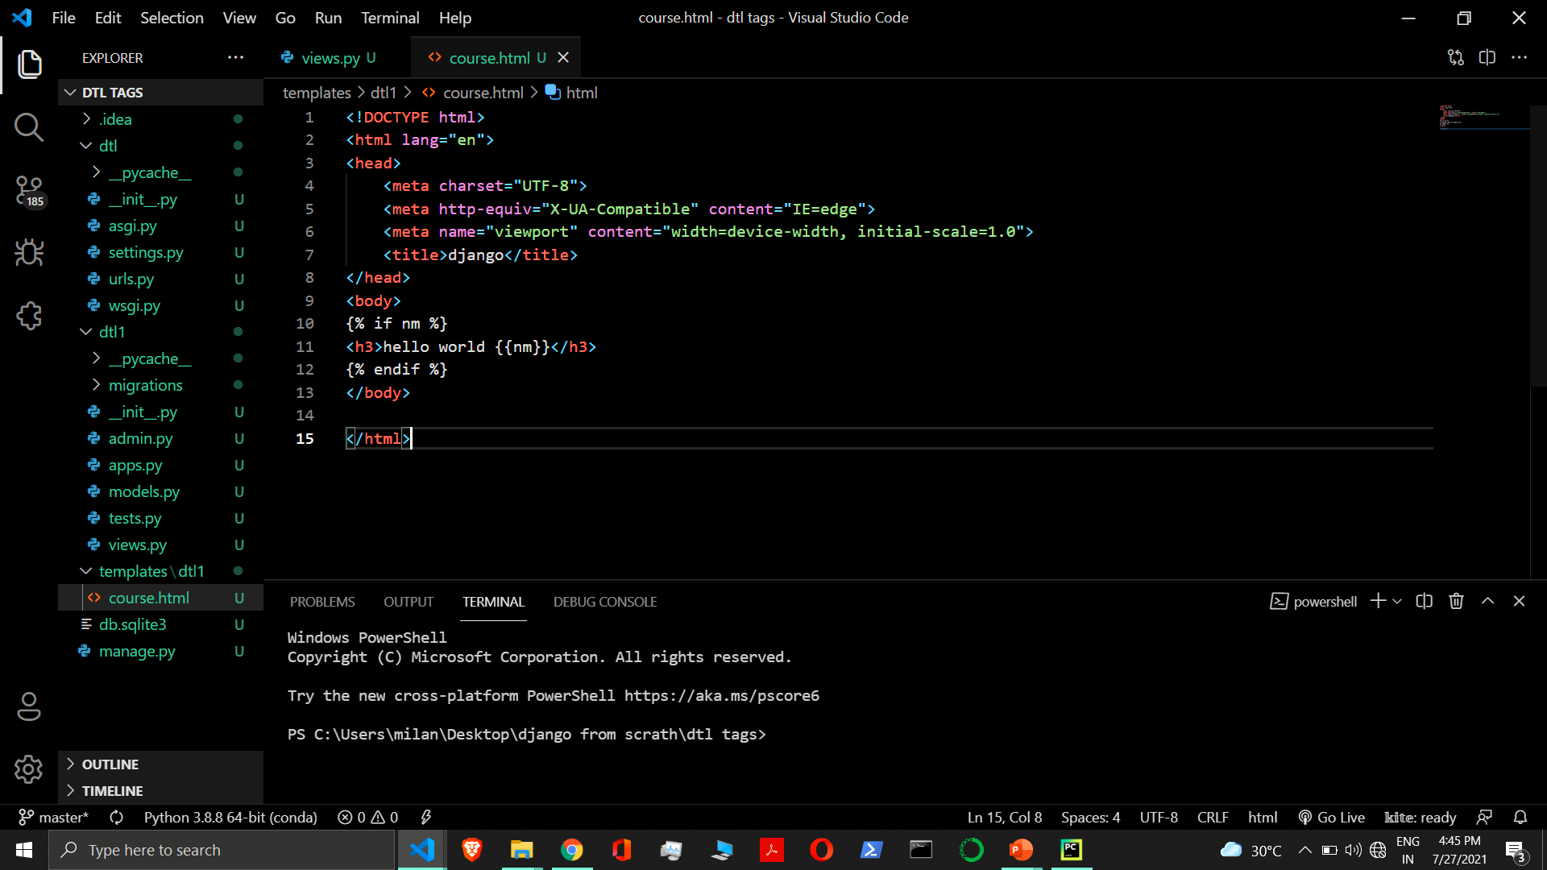

Slide 56
Static file in django
CSS files, Javascript Files, image files, video files etc are considered as static files in Django.
Django provides django.contrib.staticfiles to help you manage them.
django.contrib.staticfiles collects static files from each of your applications (and any other places you specify) into a single location that can easily be served in production.

Slide 57
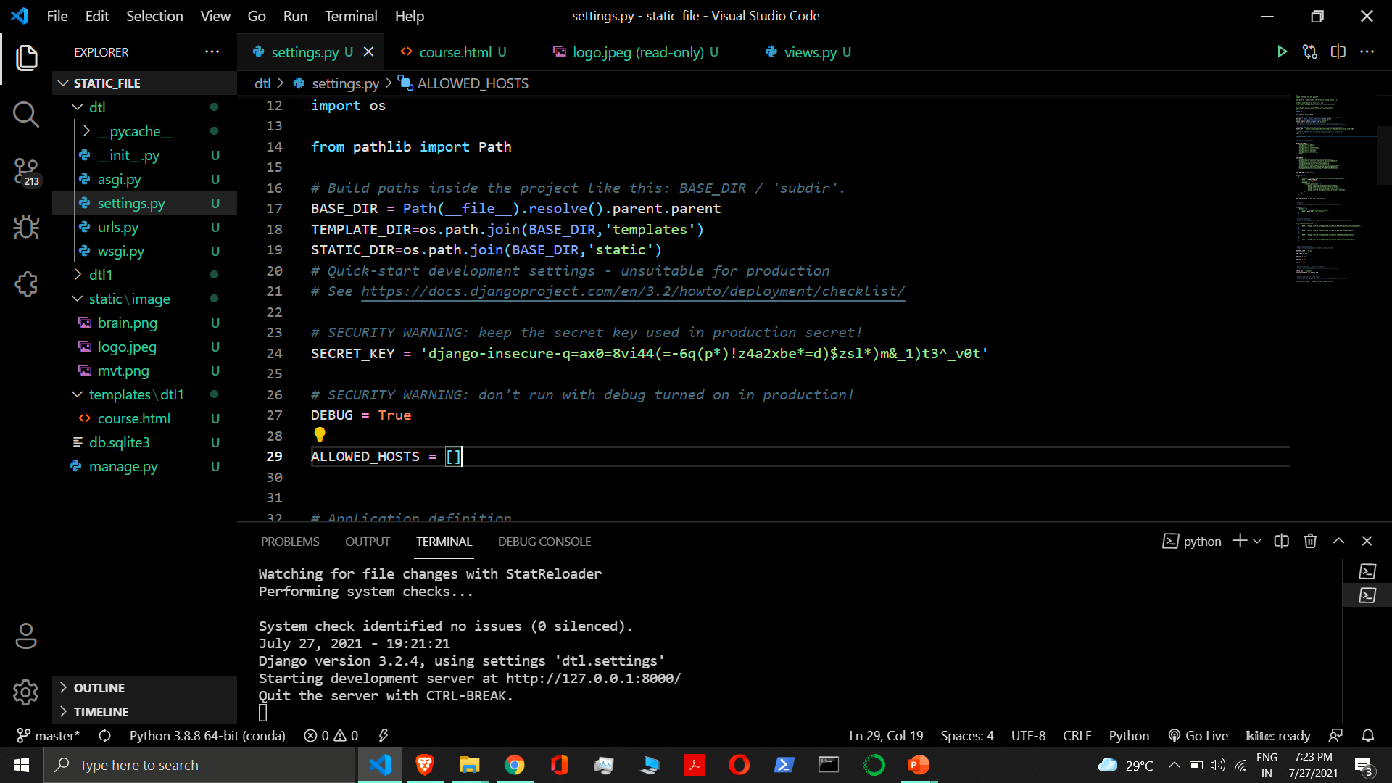

Slide 58
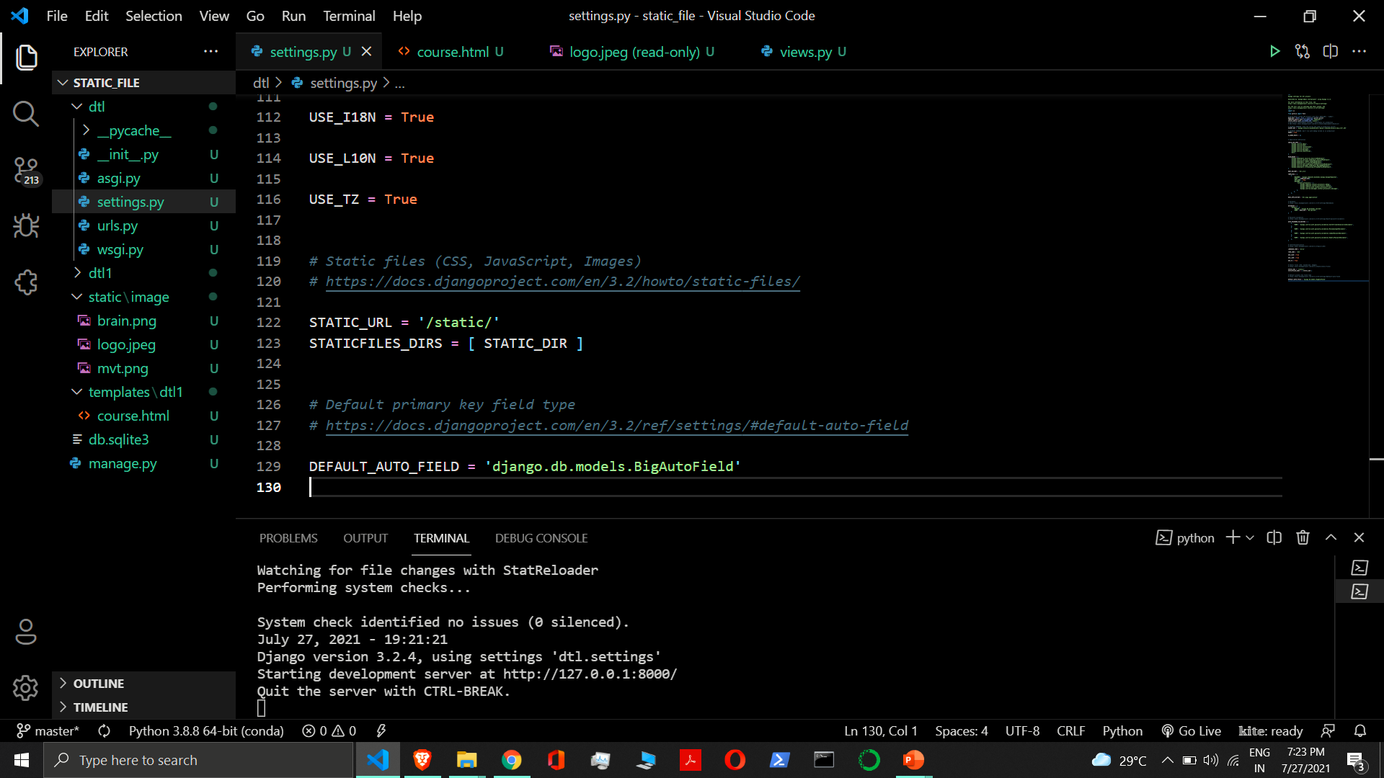

Slide 59
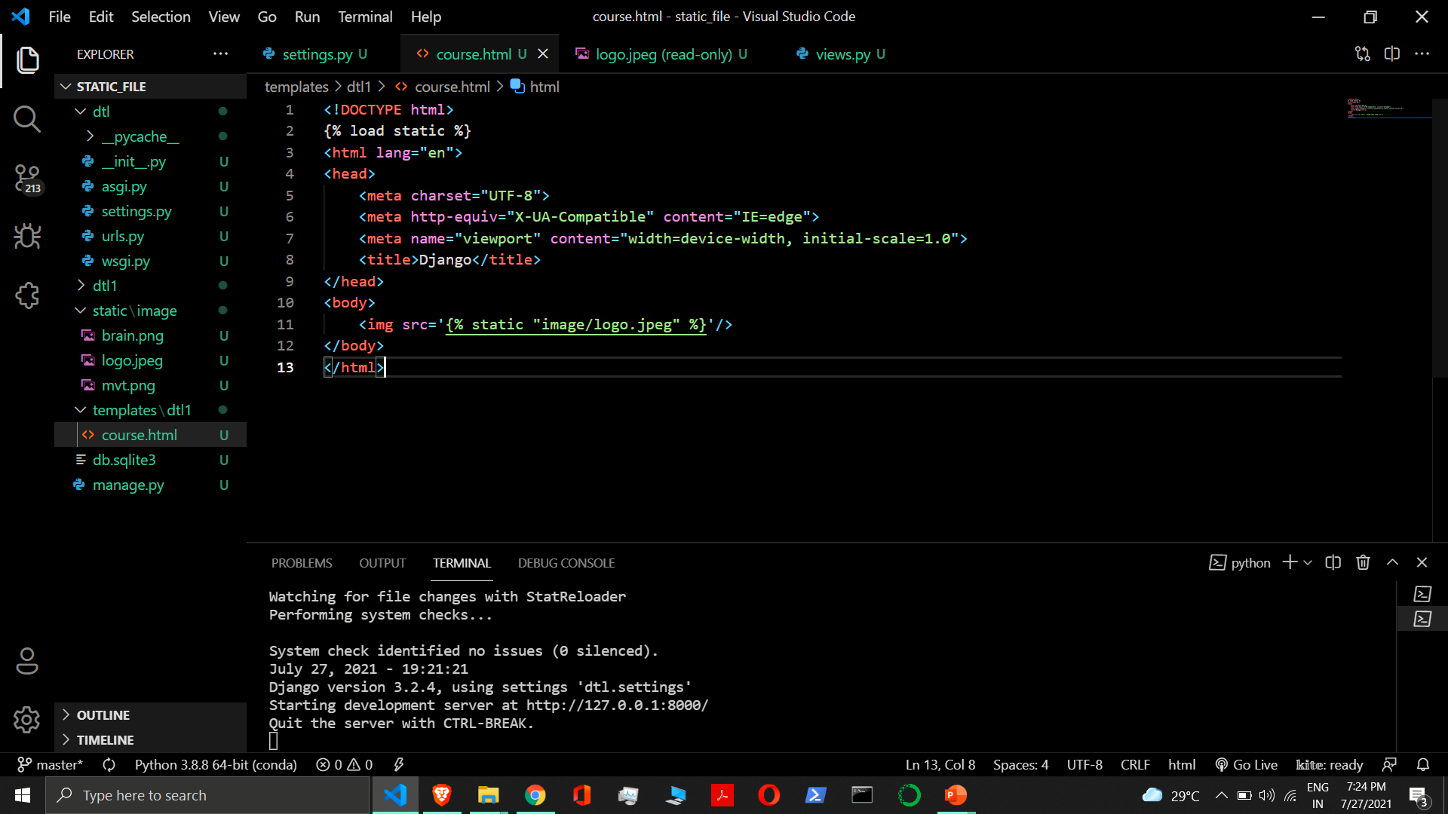

Slide 60
Templates inheritance

Slide 61
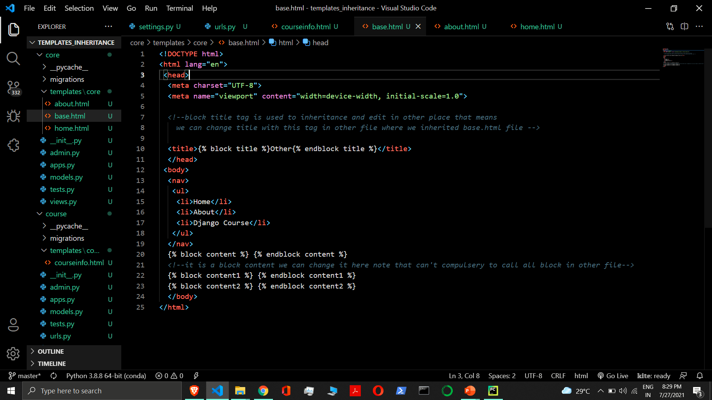

Slide 62
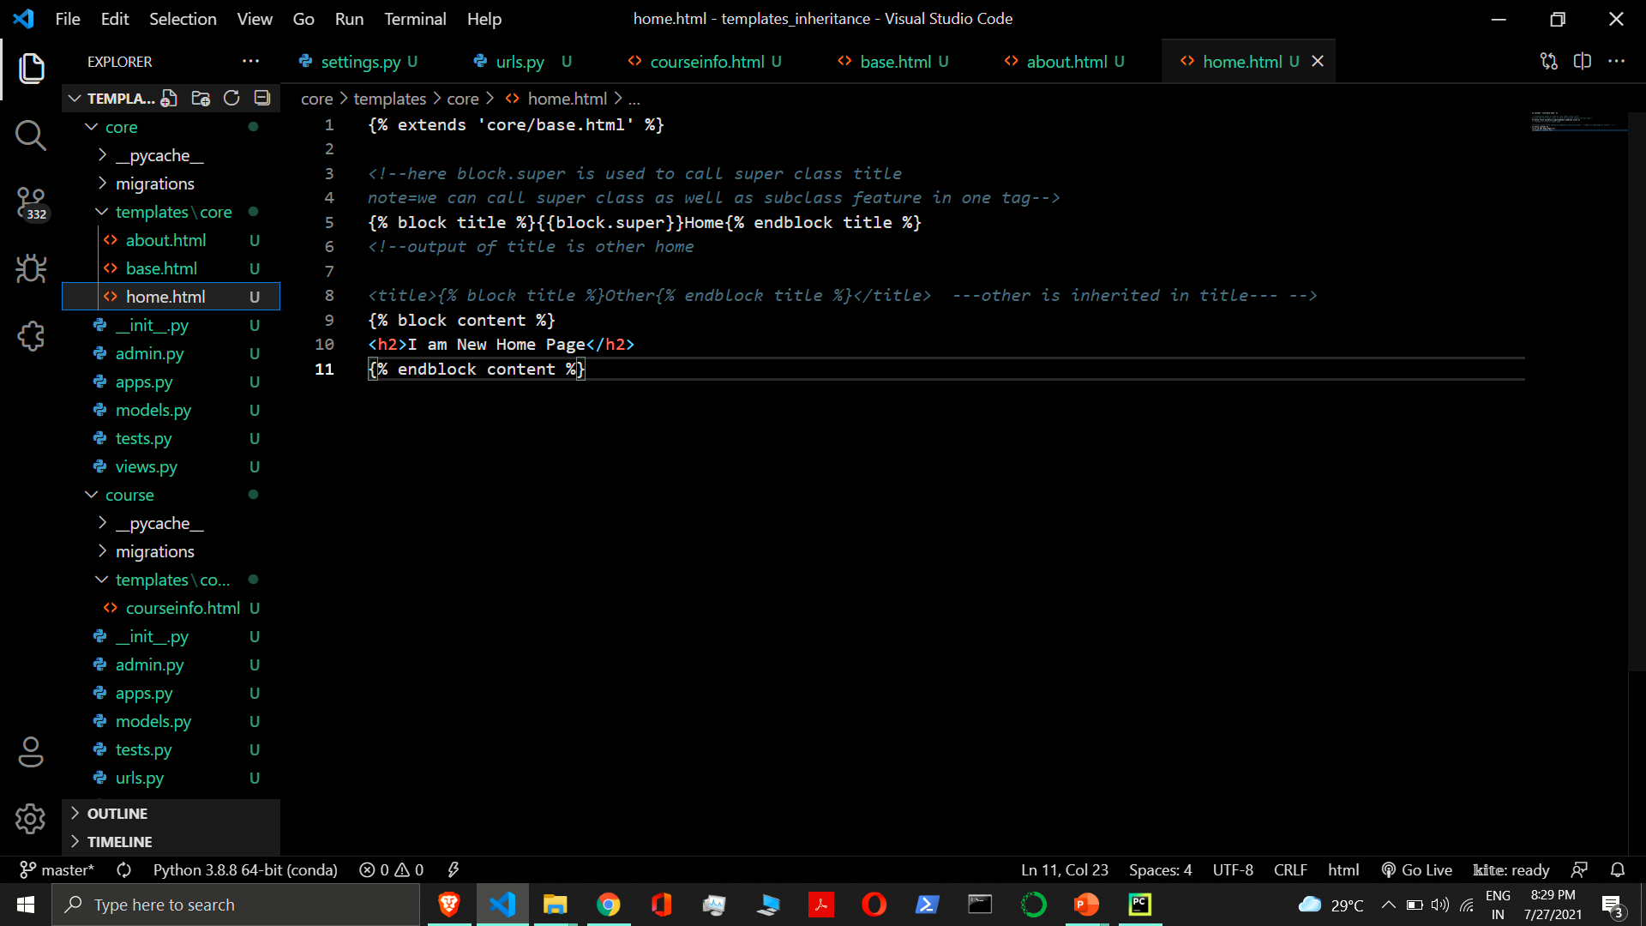

Slide 63
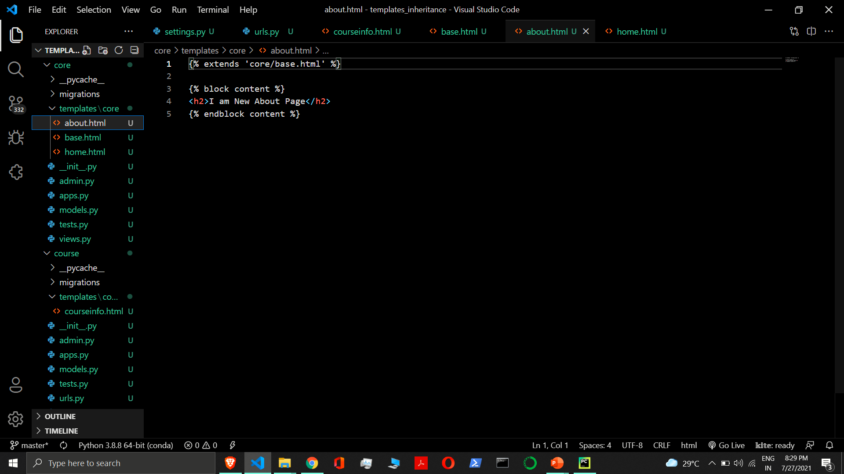

Slide 64
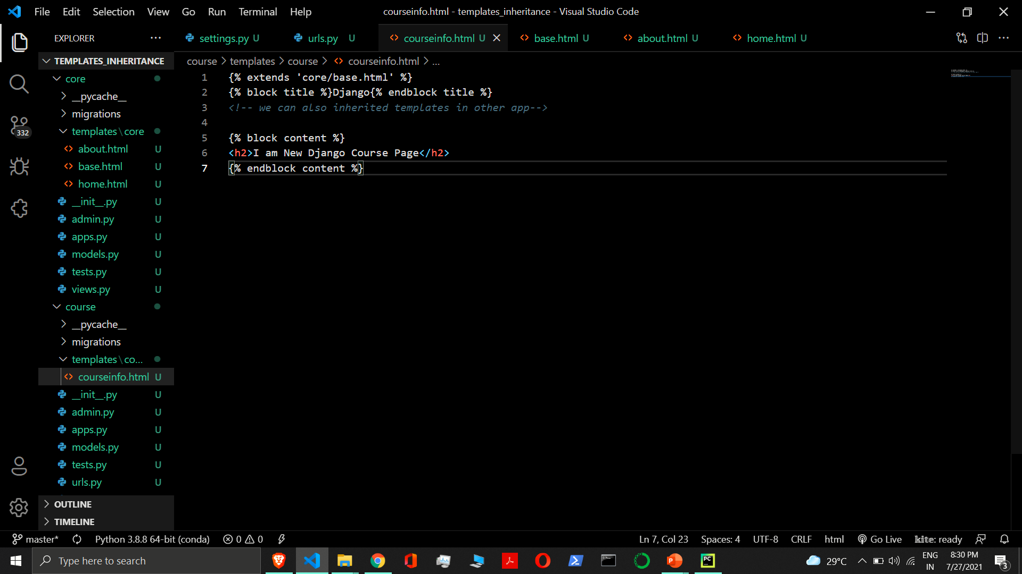

Slide 65
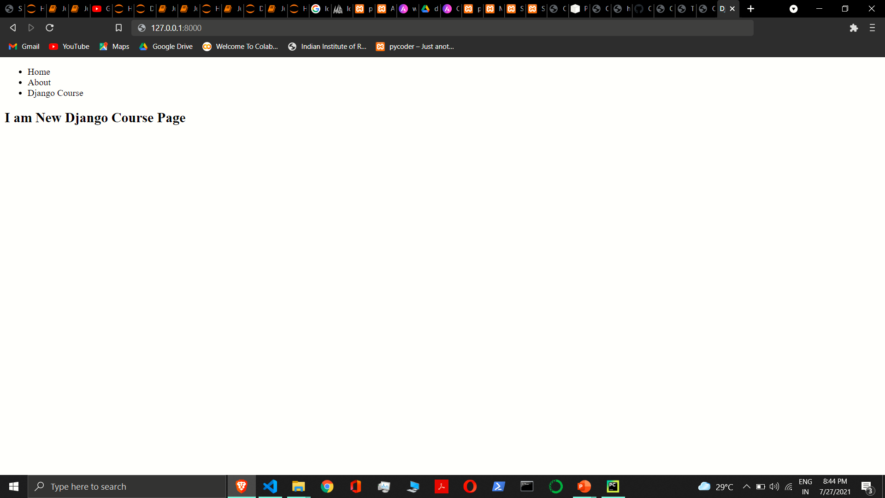

Slide 66
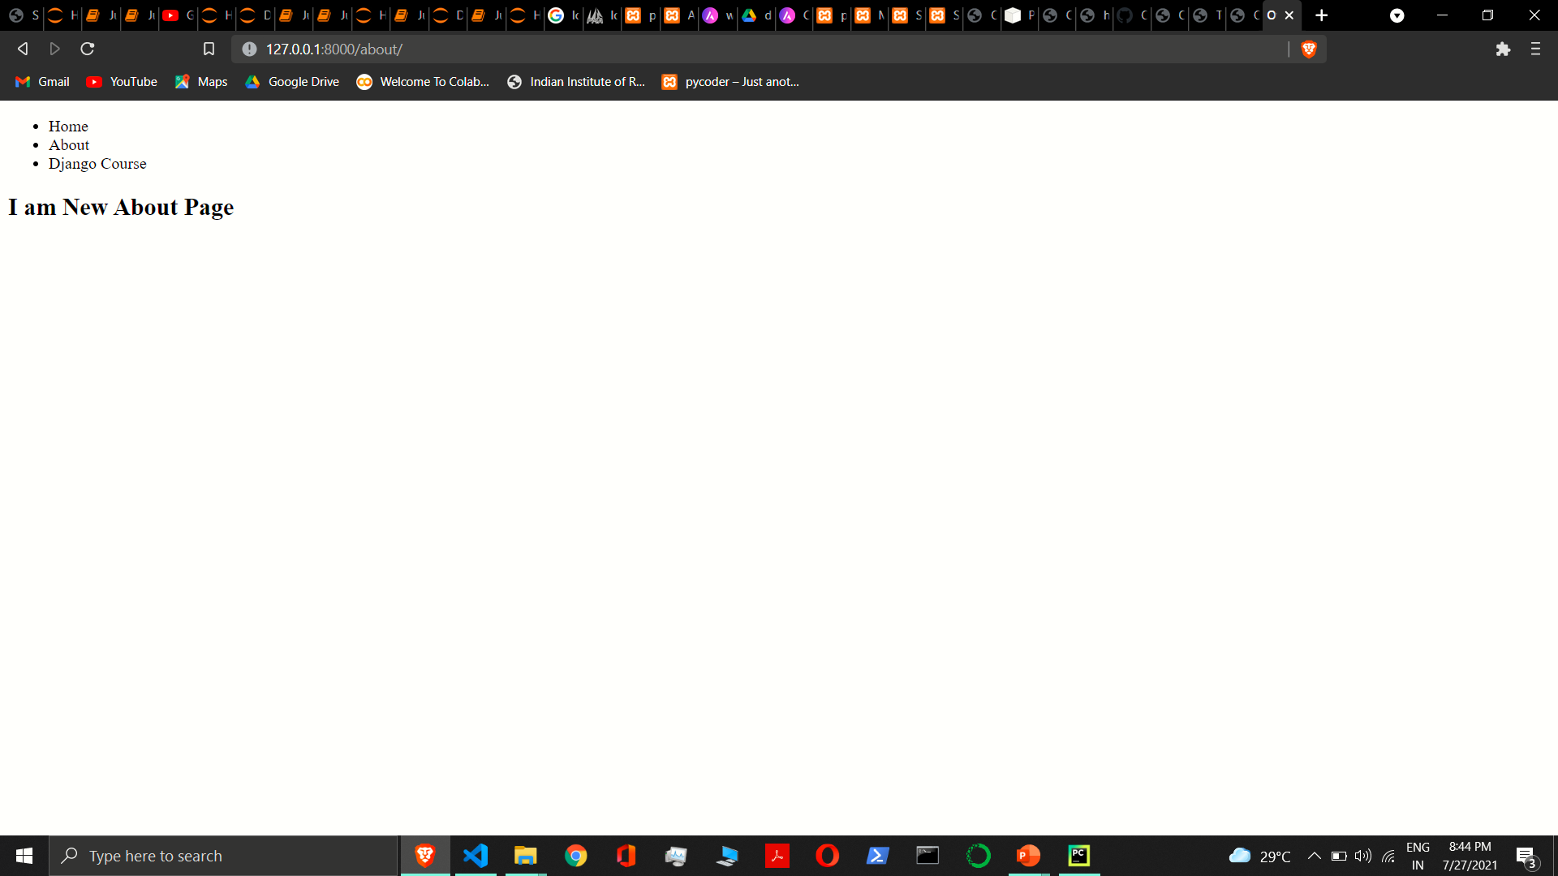

Slide 67
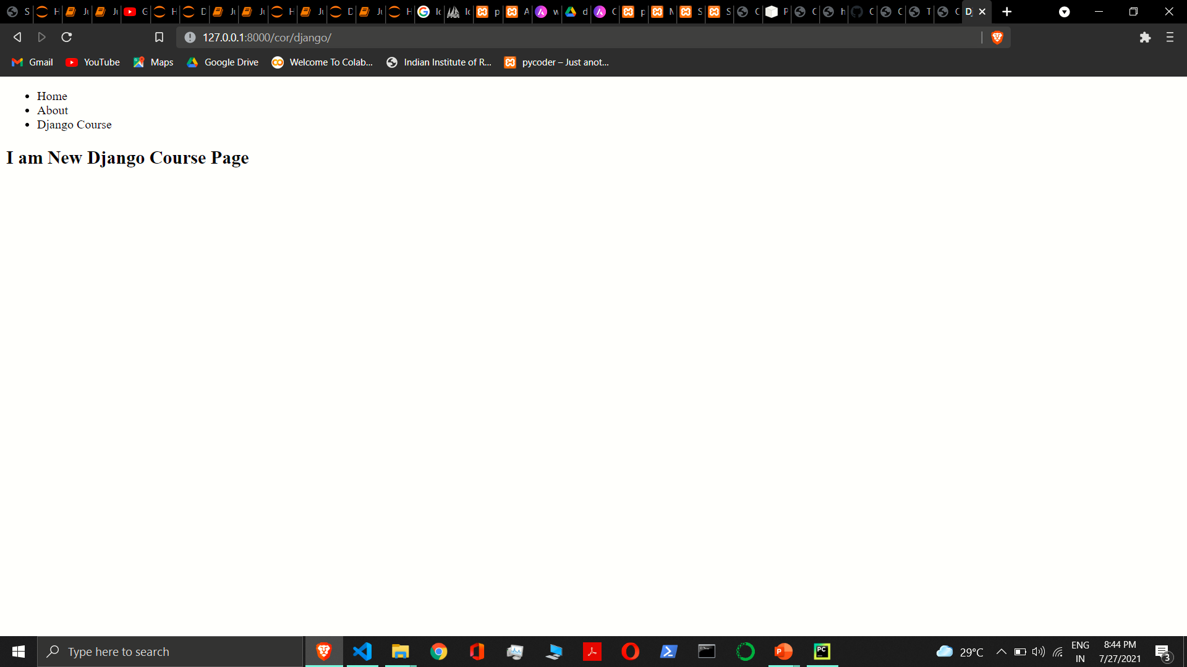

Slide 68
Url tag and url manipulation

Slide 69
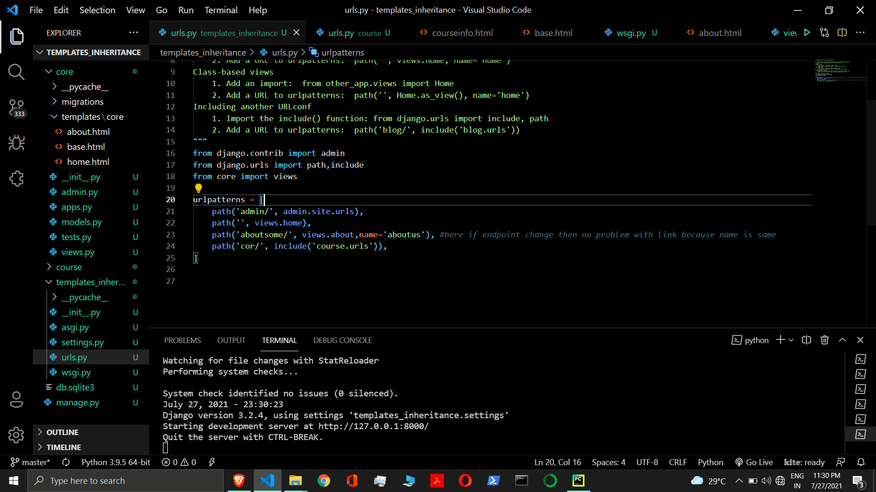

Slide 70
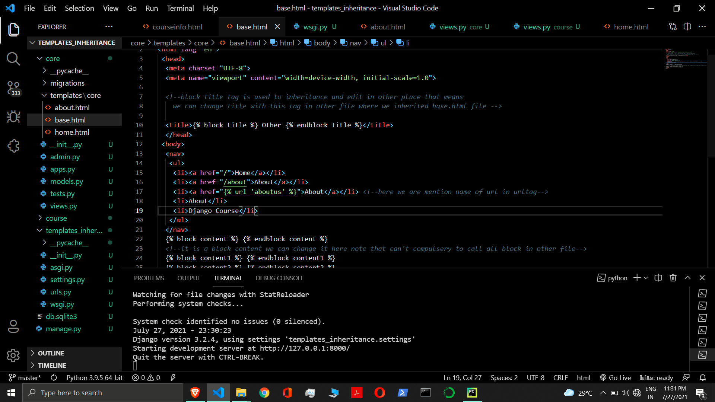

Slide 71
Include tag in dtl

Slide 72
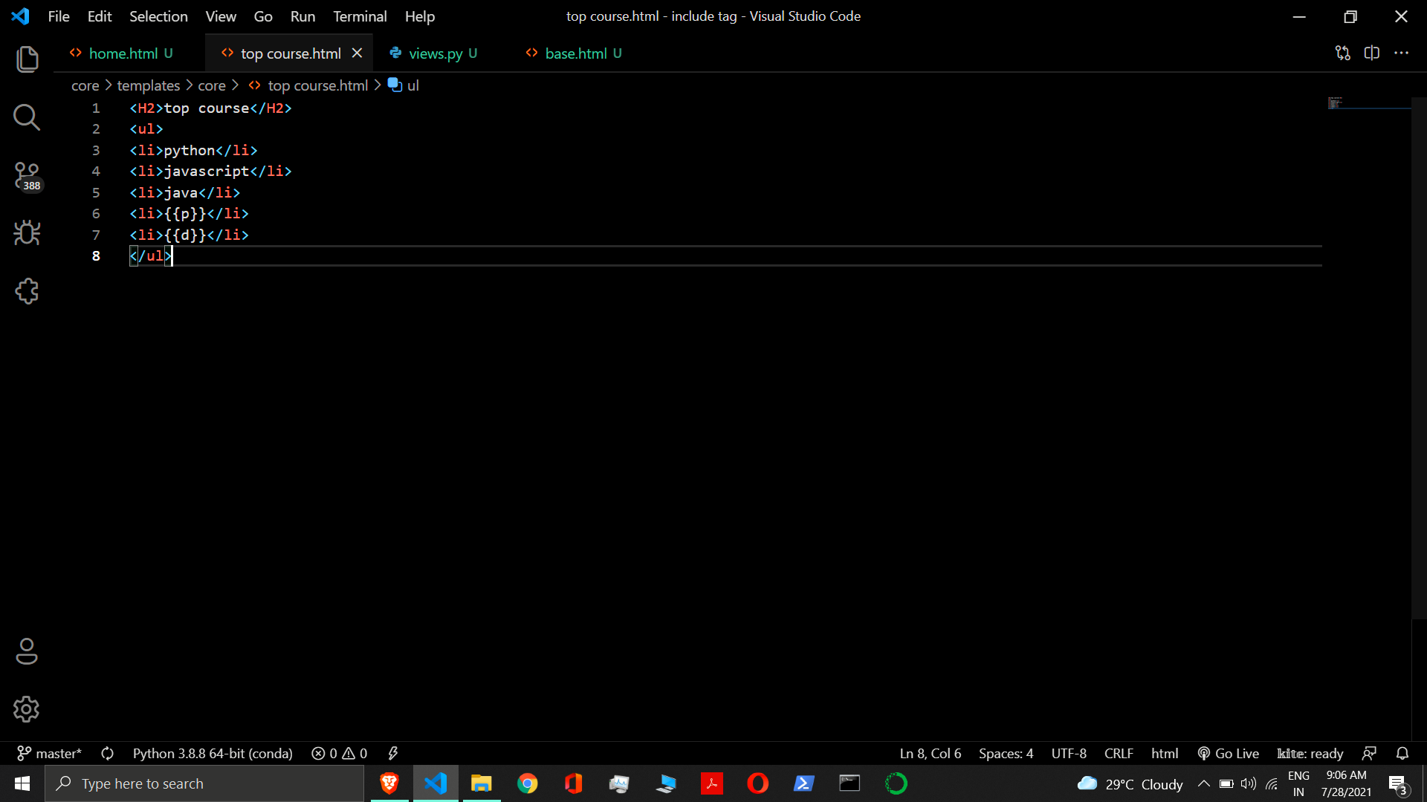

Slide 73
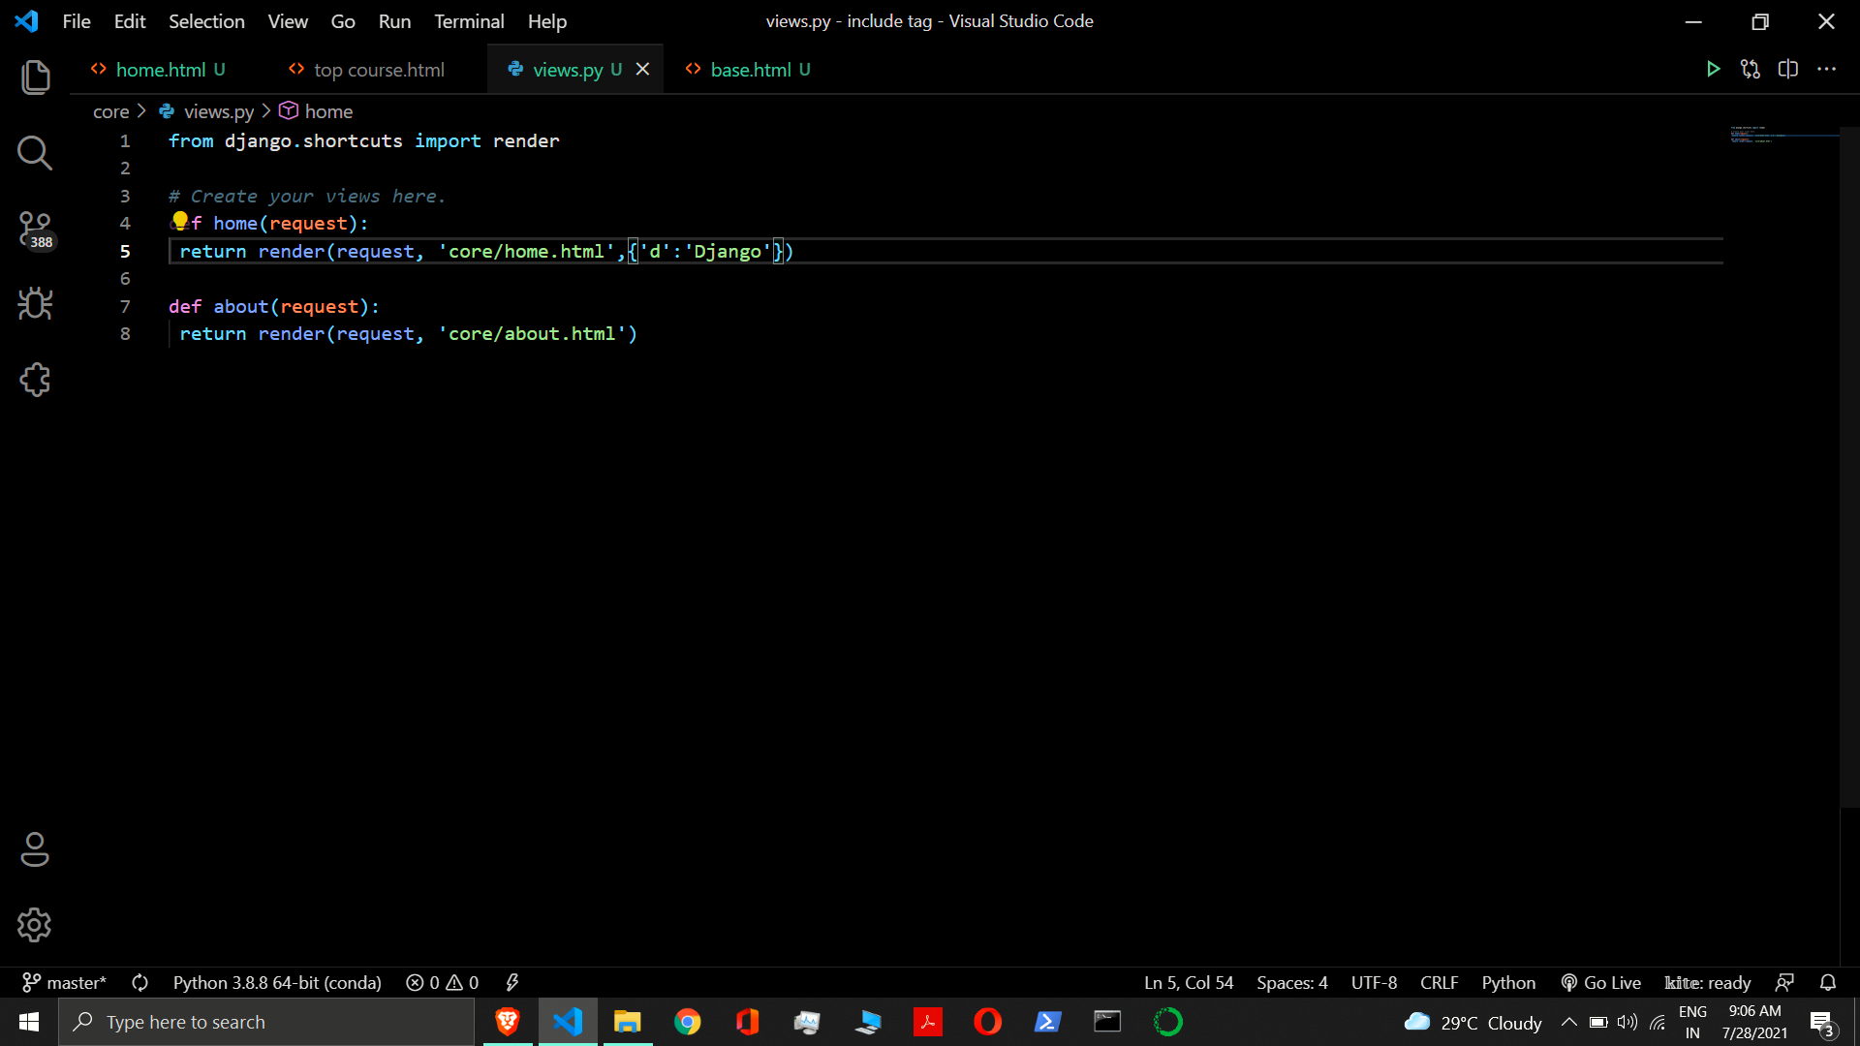

Slide 74


Slide 75


Slide 76

Object relational mapper

Slide 77






Slide 78


Slide 79


Slide 80


Slide 81


Slide 82


Slide 83


Slide 84


Slide 85

Here we are create a super user by command below
Python manage.py runserver

Slide 86



Slide 87


Slide 88
__str__()method

Slide 89


Slide 90
Django form api
To create Django form we have to create a new file inside application folder lets say file name is forms.py. Now we can write below code inside forms.py to create a form:-
Syntax:-
from django import forms
class FormClassName(forms.Form):
label=forms.FieldType()
label=forms.FieldType(label=‘display_label’)
Example:-
from django import forms
class StudentRegistration(forms.Form):
name=forms.CharField() # Here length is not required
email=forms.EmailField()

Slide 91
First of all create form object inside views.py file then pass this object to template file as a dict.
views.py
from .forms import StudentRegistration
def showformdata(request):
fm = StudentRegistration()
return render(request, ‘enroll/userregistration.html’, {‘form’:fm})

Slide 92
{{form}} doesn’t add form tag and button so we have to add them manually.
templates/enroll / userregistration.html
<!DOCTYPE html>
<html>
<body>
<form action =“” method=“get”>
{{form}}
<input type=“submit” value=“Submit”>
</form>
</body>
</html>

Slide 93
The output does not include the <table> and </table> tags, nor does it include the <form> and </form> tags or an <input type="submit"> tag. It’s your job to do that.
Each field type has a default HTML representation. CharField is represented by an <input type="text"> and EmailField by an <input type=“email” >.
The HTML name for each tag is taken directly from its attribute name in the StudentRegistration class.
The text label for each field e.g. ‘Name:’ and ‘Email:' is generated from the field name by converting all underscores to spaces and upper-casing the first letter.
Each text label is surrounded in an HTML <label> tag, which points to the appropriate form field via its id.
Its id, in turn, is generated by prepending 'id_' to the field name. The id attributes and <label> tags are included in the output by default.
The output uses HTML5 syntax, targeting <!DOCTYPE html>

Slide 94
Form rendering
{{form}} will render them all
{{ form.as_table }} will render them as table cells wrapped in <tr> tags
{{ form.as_p }} will render them wrapped in <p> tags
{{ form.as_ul }} will render them wrapped in <li> tags
{{ form.name_of_field }} will render field manually as given
<form action =“” method=“get”>
{{form}}
<input type=“submit” value=“Submit”>
</form>
<form action =“” method=“get”>
{{form.as_p}}
<input type=“submit” value=“Submit”>
</form>

Slide 95
Configure id attribute
Example:-
fm = StudentRegistration(auto_id=False)
fm = StudentRegistration(auto_id=‘geeky’)
If auto_id is set to a string containing the format character '%s', then the form output will include <label> tags, and will generate id attributes based on the format string.
If auto_id is set to True, then the form output will include <label> tags and will use the field name as its id for each form field.
If auto_id is False, then the form output will not include <label> tags nor id attributes.
If auto_id is set to any other true value – such as a string that doesn’t include %s – then the library will act as if auto_id is True.

Slide 96
Label_suffix id
label_suffix - A translatable string (defaults to a colon (:) in English) that will be appended after any label name when a form is rendered.
It’s possible to customize that character, or omit it entirely, using the label_suffix parameter.
The label suffix is added only if the last character of the label isn’t a punctuation character (in English, those are ., !, ? or :)
fm = StudentRegistration(label_suffix=‘ ’)

Slide 97
Ordering formfield
order_fields(field_order) – This method is used to rearrange the fields any time with a list of field names as in field_order. By default Form.field_order=None, which retains the order in which you define the fields in your form class.
If field_order is a list of field names, the fields are ordered as specified by the list and remaining fields are appended according to the default order.
Unknown field names in the list are ignored.
fm = StudentRegistration()
fm.order_fields(field_order=[‘email’, ‘name’ ])

Slide 98


Slide 99


Slide 100


Slide 101


Slide 102


Slide 103


Slide 104


Slide 105


Slide 106

I

Slide 107

Here
name=name
Name=email
Is output of auto_id=true

Slide 108


Slide 109


Slide 110


Slide 111


Slide 112


Slide 113


Slide 114
Get Django Form Data in Terminal

Slide 115


Slide 116


Slide 117

Password validation

Slide 118
Get form data in database

Slide 119


Slide 120


Slide 121


Slide 122


Slide 123
Form api
forms.py
from django.core import validators
from django import forms
class StudentRegistration(forms.Form):
name = forms.CharField()
email = forms.EmailField()
password = forms.CharField(widget=forms.PasswordInput)
models.py
from django.db import models
class User(models.Model):
name = models.CharField(max_length=70)
email = models.EmailField(max_length=100)
password = models.CharField(max_length=100)
views.py
def showformdata(request):
if request.method == 'POST':
fm = StudentRegistration(request.POST)
if fm.is_valid():
nm = fm.cleaned_data['name']
em = fm.cleaned_data['email']
pw = fm.cleaned_data['password']
reg = User(name=nm, email=em, password=pw)
reg.save()
templatefile.html
<form action="" method="POST" novalidate>
{% csrf_token %}
{{form.as_p}}
<input type="submit" value="Submit">
</form>

Slide 124
Model form

Slide 125


Slide 126


Slide 127


Slide 128


Slide 129
Selecting form field
Set the fields attribute to field names
class Registration(forms.ModelForm):
class Meta:
model = User
fields = [‘name’, ‘password’, ‘email’]
Set the fields attribute to the special value __all__ to indicate that all fields in the model should be used.
class Registration(forms.ModelForm):
class Meta:
model = User
fields = ‘__all__’

Slide 130
Selecting form field
Set the exclude attribute of the ModelForm’s inner Meta class to a list of fields to be excluded from the form.
class Registration(forms.ModelForm):
class Meta:
model = User
exclude = [‘name’]

Slide 131
Model form inheritance
Normal Python name resolution rules apply. If you have multiple base classes that declare a Meta inner class, only the first one will be used. This means the child’s Meta, if it exists, otherwise the Meta of the first parent, etc.
It’s possible to inherit from both Form and ModelForm simultaneously, however, you must ensure that ModelForm appears first in the MRO. This is because these classes rely on different metaclasses and a class can only have one metaclass.
It’s possible to declaratively remove a Field inherited from a parent class by setting the name to be None on the subclass.

Slide 132
Dynamic url
urlpatterns = [
path(‘student/', views.show_details, name=“detail”),
path(‘student/<my_id>/', views.show_details, name=“detail”),
path(‘student/<int:my_id>/', views.shows_details, name=“detail”),
path(‘student /<int:my_id>/<int:my_subid>/', views.shows_details, name=“detail”),
path(‘student/<int:id>/<int:subid>/<slug:my_slug>/', views.shows_details, name=“detail”),
]

Slide 133

Path converter

Slide 134


Slide 135


Slide 136


Slide 137


Slide 138


Slide 139


Slide 140
Custom path converter
Create a Path Converter Class
class FourDigitYearConverter:
regex = '[0-9]{4}'
def to_python(self, value):
return int(value)
def to_url(self, value):
return '%04d' % value
Where
regex is an attribute, as a string.
to_python(self, value) method, which handles converting the matched string into the type that should be passed to the view function. It should raise ValueError if it can’t convert the given value. A ValueError is interpreted as no match and as a consequence a 404 response is sent to the user unless another URL pattern matches.
to_url(self, value) method, which handles converting the Python type into a string to be used in the URL.

Slide 141
Custom path converter
Register Path Converter
urls.py
from django.urls import path, register_converter
from . import converters, views
register_converter(converters.FourDigitYearConverter, ‘yyyy')
urlpatterns = [
path('session/<yyyy:year>/', views.show_details, name="detail")
]

Slide 142
Messages framework
The messages framework allows you to temporarily store messages in one request and retrieve them for display in a subsequent request.
Django provides full support for cookie- and session-based messaging, for both anonymous and authenticated users.
INSTALLED_APPS = [ 'django.contrib.messages' ]
MIDDLEWARE = [ 'django.contrib.sessions.middleware.SessionMiddleware', 'django.contrib.messages.middleware.MessageMiddleware' ]
‘context_processors’: ['django.contrib.messages.context_processors.messages’]

Slide 143
Messages level and tags
Level | Tag | Value | Purpose
DEBUG | debug | 10 | Development related messages that will be ignored or removed in a production deployment
INFO | info | 20 | Informational messages for the user
SUCCESS | success | 25 | An action was successful, e.g. “Updated successfully”
WARNING | warning | 30 | A failure did not occur but may be imminent
ERROR | error | 40 | An action was not successful or some other failure occurred

Slide 144
Get level and set level
get_level ( ) - This method is used to retrieved the current effective level.
from django.contrib import messages
current_level = messages.get_level(request)
set_level ( ) - This method is used to set minimum recorded level.
from django.contrib import messages
messages.set_level(request, messages.DEBUG)
This will record messages with a level of DEBUG and higher.

Slide 145
Display message
Display Message:-
{% if messages %}
{% for message in messages %}
<p {% if message.tags %} class="alert-{{message.tags}}" {% endif %} >
{{message}}
</p>
{% endfor %}
{% endif %}

Slide 146


Slide 147


Slide 148


Slide 149
Constants messages
Open settings.py
from django.contrib.messages import constants as messages
MESSAGE_TAGS = {
messages.ERROR: 'danger',
}

Slide 150


Slide 151


Slide 152

Used creation for with default authentication system

Slide 153


Slide 154


Slide 155


Slide 156


Slide 157


Slide 158

Get form data in database

Slide 159


Slide 160


Slide 161


Slide 162


Slide 163
Profile authentication

Slide 164


Slide 165


Slide 166


Slide 167


Slide 168


Slide 169


Slide 170
Password change form

Slide 171


Slide 172


Slide 173


Slide 174
User profile

Slide 175


Slide 176


Slide 177
User permission and authorization

Slide 178


Slide 179


Slide 180
Django cookies

Slide 181
Set cookie
set_cookie() – set_cookie() is used to set/create/sent cookies.
Syntax: - HttpResponse.set_cookie(key, value='', max_age=None, expires=None, path='/', domain=None, secure=False, httponly=False, samesite=None)
Example: - set_cookie( “name”, “milan”)
key − This is the name of the cookie.
value − This sets the value of cookie. This value is stored on the clients computer.
name and value are required to set cookie.
When you omit the optional cookie fields, the browser fills them in automatically with reasonable defaults.

Slide 182
Accessing cookies
HttpRequest.COOKIES - A dictionary containing all cookies. Keys and values are strings.
Syntax:- request.COOKIES[‘key’];
Example: - request.COOKIES[‘name’];
Syntax:- request.COOKIES.get(‘key’, default)
Example: - request.COOKIES.get(‘name’)
Example: - request.COOKIES.get(‘name’, “Guest”)

Slide 183


Slide 184


Slide 185


Slide 186


Slide 187

Append/replace cookies
When we assign a new value to cookie, the current cookie are not replaced. The new cookie is parsed and its name-value pair is appended to the list. The exception is when you assign a new cookie with the same name (and same domain and path, if they exist) as a cookie that already exists. In this case the old value is replaced with the new.
Examples:-
set_cookie(“name”, “milan”)
set_cookie(“name”, “rahul”)
set_cookie(“name”, “sonam”)
set_cookie(“lname”, “jha”)

Slide 188
Delete cookies
HttpResponse.delete_cookie(key, path='/', domain=None) – This method is used to delete the cookie based on given key with same domain and path, if they were set, otherwise the cookie may not be deleted.
Example: - delete_cookie(‘name’)

Slide 189
Signed cookie
HttpResponse.set_signed_cookie(key, value, salt='', max_age=None, expires=None, path='/', domain=None, secure=False, httponly=False, samesite=None) –
It is similar to set_cookie(), but cryptographic signing the cookie before setting it. Use in conjunction with HttpRequest.get_signed_cookie().
You can use the optional salt argument for added key strength, but you will need to remember to pass it to the corresponding HttpRequest.get_signed_cookie() call.

Slide 190
Getting signed cookies
HttpRequest.get_signed_cookie(key, default=RAISE_ERROR, salt='', max_age=None) –
It returns a cookie value for a signed cookie, or raises a django.core.signing.BadSignature exception if the signature is no longer valid.
If you provide the default argument the exception will be suppressed and that default value will be returned instead.
The optional salt argument can be used to provide extra protection against brute force attacks on your secret key. If supplied, the max_age argument will be checked against the signed timestamp attached to the cookie value to ensure the cookie is not older than max_age seconds.

Slide 191


Slide 192
Session
When SessionMiddleware is activated, each HttpRequest object, the first argument to any Django view function will have a session attribute, which is a dictionary-like object.
You can read it and write to request.session at any point in your view. You can edit it multiple times.
Set Item
request.session['key'] = 'value’
Get Item
returned_value = request.session['key']
returned_value = request.session.get('key', default=None)

Slide 193
session
Delete Item
del request.session['key’]
This raises KeyError if the given key isn’t already in the session.
Contains
'key' in request.session

Slide 194
Session method
keys() method returns a view object that displays a list of all the keys in the dictionary.
Syntax:- dict.keys()
items() method returns the list with all dictionary keys with values.
Syntax:- dict.items()
clear() function is used to erase all the elements of list. After this operation, list becomes empty.
Syntax:- dict.clear()

Slide 195
Session method
setdefault() method returns the value of a key (if the key is in dictionary). If not, it inserts key with a value to the dictionary.
Syntax: dict.setdefault(key, default_value)
flush() – It deletes the current session data from the session and deletes the session cookie. This is used if you want to ensure that the previous session data can’t be accessed again from the user’s browser (for example, the django.contrib.auth.logout() function calls it).

Slide 196
Session method
get_session_cookie_age() – It returns the age of session cookies, in seconds. Defaults to SESSION_COOKIE_AGE.
set_expiry(value) – It sets the expiration time for the session. You can pass a number of different values:
If value is an integer, the session will expire after that many seconds of inactivity. For example, calling request.session.set_expiry(300) would make the session expire in 5 minutes.
If value is a datetime or timedelta object, the session will expire at that specific date/time. Note that datetime and timedelta values are only serializable if you are using the PickleSerializer.
If value is 0, the user’s session cookie will expire when the user’s Web browser is closed.
If value is None, the session reverts to using the global session expiry policy.
Reading a session is not considered activity for expiration purposes. Session expiration is computed from the last time the session was modified.

Slide 198


Slide 199


Slide 200


Slide 201


Slide 202


Slide 203


Slide 204


Slide 205


Slide 206


Slide 207
caching

Slide 208
Per-site cache
The per-site cache – Once the cache is set up, the simplest way to use caching is to cache your entire site.
MIDDLEWARE = [
'django.middleware.cache.UpdateCacheMiddleware',
'django.middleware.common.CommonMiddleware',
'django.middleware.cache.FetchFromCacheMiddleware’,
]
CACHE_MIDDLEWARE_ALIAS – The cache alias to use for storage.
CACHE_MIDDLEWARE_SECONDS – The number of seconds each page should be cached.
CACHE_MIDDLEWARE_KEY_PREFIX – If the cache is shared across multiple sites using the same Django installation, set this to the name of the site, or some other string that is unique to this Django instance, to prevent key collisions. Use an empty string if you don’t care.

Slide 209
dATAbase cache
Django can store its cached data in your database. This works best if you’ve got a fast, well-indexed database server.
CACHES = {
'default': {
'BACKEND': 'django.core.cache.backends.db.DatabaseCache',
'LOCATION': 'my_cache_table',
}
}
Before using the database cache, you must create the cache table with this command:
python manage.py createcachetable
This creates a table in your database that is in the proper format that Django’s database-cache system expects. The name of the table is taken from LOCATION.
If you are using multiple database caches, createcachetable creates one table for each cache.

Slide 210
Cache Arguments
CACHES = {
'default': {
'BACKEND': 'django.core.cache.backends.db.DatabaseCache',
'LOCATION': ‘enroll_cache',
'TIMEOUT': 60,
'OPTIONS': {
'MAX_ENTRIES': 1000
}
}
}

Slide 211
Dummy caching
Django comes with a “dummy” cache that doesn’t actually cache – it just implements the cache interface without doing anything.
This is useful if you have a production site that uses heavy-duty caching in various places but a development/test environment where you don’t want to cache and don’t want to have to change your code to special-case the latter.
CACHES = {
'default': {
'BACKEND': 'django.core.cache.backends.dummy.DummyCache',
}
}

Slide 212
Per view cache
The per-view cache - A more granular way to use the caching framework is by caching the output of individual views. django.views.decorators.cache defines a cache_page decorator that will automatically cache the view’s response. If multiple URLs point at the same view, each URL will be cached separately.
from django.views.decorators.cache import cache_page
@cache_page(timeout, cache, key_prefix)
def my_view(request):
timeout - The cache timeout, in seconds.
cache – This directs the decorator to use a specific cache (from your CACHES setting) when caching view results. By default, the default cache will be used.
Key_prefix - You can also override the cache prefix on a per-view basis. It works in the same way as the CACHE_MIDDLEWARE_KEY_PREFIX setting for the middleware.
@cache_page(60, cache=“some_cache”, key_prefix=“some_key”)
def home(request):

Slide 213
Per view cache in url
Specifying per-view cache in the URLconf
from django.views.decorators.cache import cache_page
urlpatterns = [
path(‘route/', cache_page(timeout, cache, key_prefix)(view_function)),
]
urlpatterns = [
path('home/', cache_page(60)(views.home), name=“home”),
]

Slide 214
Database cache
Django can store its cached data in your database. This works best if you’ve got a fast, well-indexed database server.
CACHES = {
'default': {
'BACKEND': 'django.core.cache.backends.db.DatabaseCache',
'LOCATION': 'my_cache_table',
}
}
Before using the database cache, you must create the cache table with this command:
python manage.py createcachetable
This creates a table in your database that is in the proper format that Django’s database-cache system expects. The name of the table is taken from LOCATION.
If you are using multiple database caches, createcachetable creates one table for each cache.

Slide 215
Cache arguments
CACHES = {
'default': {
'BACKEND': 'django.core.cache.backends.filebased.FileBasedCache',
'LOCATION': ‘c:/Django code/gs80',
'TIMEOUT': 60,
'OPTIONS': {
'MAX_ENTRIES': 1000
}
}
}

Slide 216
Dummy cache
Django comes with a “dummy” cache that doesn’t actually cache – it just implements the cache interface without doing anything.
This is useful if you have a production site that uses heavy-duty caching in various places but a development/test environment where you don’t want to cache and don’t want to have to change your code to special-case the latter.
CACHES = {
'default': {
'BACKEND': 'django.core.cache.backends.dummy.DummyCache',
}
}

Slide 217
Templates fragment caching
This gives you more control what to cache.
{% load cache %} – This gives access to cache tag in template.
{% cache %} - This template tag caches the contents of the block for a given amount of time.
Syntax:-
{% cache timeout name variable using=“ ” %} ….. {% endcache name %}
Timeout - The cache timeout, in seconds. The fragment is cached forever if timeout is None. It can be a template variable, as long as the template variable resolves to an integer value.
Name - The name to give the cache fragment. The name will be taken as is, do not use a variable.
Variable – This can be a variable with or without filters. This will cache multiple copies of a fragment depending on some dynamic data that appears inside the fragment.
using - The cache tag will try to use the given cache. If no such cache exists, it will fall back to using the default cache. You may select an alternate cache backend to use with the using keyword argument, which must be the last argument to the tag.

Slide 218
example
Example:-
{% load cache %}
{% cache 60 sidebar request.user.username using=“localcache” %}
.. sidebar for logged in user ..
{% endcache %}

Slide 219
Cache arguments
CACHES = {
'default': {
'BACKEND': 'django.core.cache.backends.filebased.FileBasedCache',
'LOCATION': ‘c:\Djangocode\gs85\cache',
'TIMEOUT': 60,
'OPTIONS': {
'MAX_ENTRIES': 1000
}
}
}

Slide 220
Dummy cache
Django comes with a “dummy” cache that doesn’t actually cache – it just implements the cache interface without doing anything.
This is useful if you have a production site that uses heavy-duty caching in various places but a development/test environment where you don’t want to cache and don’t want to have to change your code to special-case the latter.
CACHES = {
'default': {
'BACKEND': 'django.core.cache.backends.dummy.DummyCache',
}
}

Slide 221
Low level api
Sometimes, caching an entire rendered page doesn’t gain you very much and is, in fact, inconvenient overkill.
Perhaps, for instance, your site includes a view whose results depend on several expensive queries, the results of which change at different intervals. In this case, it would not be ideal to use the full-page caching that the per-site or per-view cache strategies offer, because you wouldn’t want to cache the entire result (since some of the data changes often), but you’d still want to cache the results that rarely change.
For cases like this, Django exposes a low-level cache API. You can use this API to store objects in the cache with any level of granularity you like. You can cache any Python object that can be pickled safely: strings, dictionaries, lists of model objects, and so forth.
django.core.cache.cache

Slide 222
Low level api
from django.core.cache import cache
cache.set(key, value, timeout=DEFAULT_TIMEOUT, version=None) – This method is used to set cache.
Where,
key –It should be str.
value – It can be any pickleable Python object.
timeout – It is number of seconds the value should be stored in the cache. Timeout of None will cache the value forever. A timeout of 0 won’t cache the value.
version – It is an int. You can set cache with same key but different version.
cache.get(key, default=None, version=None) – This method is used to get cache. If the key doesn’t exists in the cache, it returns None.
Where,
default – This specifies which value to return if the object doesn’t exist in the cache.

Slide 223
Low level api
from django.core.cache import cache
cache.add(key, value, timeout=DEFAULT_TIMEOUT, version=None) – This method is used to add a key only if it doesn’t already exist. It takes the same parameters as set(), but it will not attempt to update the cache if the key specified is already present. If you need to know whether add() stored a value in the cache, you can check the return value. It will return True if the value was stored, False otherwise.
cache.get_or_set(key, default, timeout=DEFAULT_TIMEOUT, version=None) – This method is used to get a key’s value or set a value if the key isn’t in the cache. It takes the same parameters as get() but the default is set as the new cache value for that key, rather than returned. You can also pass any callable as a default value.
cache.set_many(dict, timeout) – This method is used to set multiple values more efficiently, use set_many() to pass a dictionary of key-value pairs.
cache.get_many(keys, version=None) - There’s also a get_many() interface that only hits the cache once. get_many() returns a dictionary with all the keys you asked for that actually exist in the cache (and haven’t expired).

Slide 224
Low level api
from django.core.cache import cache
cache.delete(key, version=None) – This method is used to delete keys explicitly to clear the cache for a particular object.
cache.delete_many(keys, version=None) – This method is used to clear a bunch of keys at once. It can take a list of keys to be cleared.
cache.clear() – This method is used to delete all the keys in the cache. Be careful with this; clear() will remove everything from the cache, not just the keys set by your application.
cache.touch(key, timeout=DEFAULT_TIMEOUT, version=None) – This method is used to set a new expiration for a key. touch() returns True if the key was successfully touched, False otherwise.

Slide 225
Low level api
from django.core.cache import cache
cache.incr(key, delta=1, version=None)
cache.decr(key, delta=1, version=None)
cache.close() - You can close the connection to your cache with close() if implemented by the cache backend.
You can also increment or decrement a key that already exists using the incr() or decr() methods, respectively. By default, the existing cache value will be incremented or decremented by 1. Other increment/decrement values can be specified by providing an argument to the increment/decrement call. A ValueError will be raised if you attempt to increment or decrement a nonexistent cache key.

Slide 226
signal
The signals are utilities that allow us to associate events with actions.
Signals allow certain senders to notify a set of receivers that some action has taken place.
Login and Logout Signals
Model Signals
Management Signals
Request/Response Signals
Test Signals
Database Wrappers

Slide 227
Built in signal
Django provides a set of built-in signals that let user code get notified by Django itself of certain actions.
Login and Logout Signals - The auth framework uses the following signals that can be used for notification when a user logs in or out.
django.contrib.auth.signals
user_logged_in(sender, request, user) - Sent when a user logs in successfully.
sender - The class of the user that just logged in.
request - The current HttpRequest instance.
user - The user instance that just logged in.
user_logged_out(sender, request, user) - Sent when the logout method is called.
sender - The class of the user that just logged out or None if the user was not authenticated.
request - The current HttpRequest instance.
user - The user instance that just logged out or None if the user was not authenticated.

Slide 228
Built in signal
user_login_failed(sender, credentials, request) - Sent when the user failed to login successfully.
sender - The name of the module used for authentication.
credentials - A dictionary of keyword arguments containing the user credentials that were passed to authenticate() or your own custom authentication backend. Credentials matching a set of ‘sensitive’ patterns, (including password) will not be sent in the clear as part of the signal.
request - The HttpRequest object, if one was provided to authenticate()

Slide 229
Built in signal
Model signals - A set of signals sent by the model system.
django.db.models.signals
pre_init (sender, args, kwargs) - Whenever you instantiate a Django model, this signal is sent at the beginning of the model’s __init__() method.
sender - The model class that just had an instance created.
args - A list of positional arguments passed to __init__().
kwargs - A dictionary of keyword arguments passed to __init__().
post_init (sender, instance) - Like pre_init, but this one is sent when the __init__() method finishes.
sender - The model class that just had an instance created.
instance - The actual instance of the model that’s just been created.

Slide 230
Built in signal
pre_save (sender, instance, raw, using, update_fields) - This is sent at the beginning of a model’s save() method.
sender - The model class.
instance - The actual instance being saved.
raw - A boolean; True if the model is saved exactly as presented (i.e. when loading a fixture). One should not query/modify other records in the database as the database might not be in a consistent state yet.
using - The database alias being used.
update_fields - The set of fields to update as passed to Model.save(), or None if update_fields wasn’t passed to save().

Slide 231
Built in signal
post_save(sender, instance, created, raw, using, update_fields) - Like pre_save, but sent at the end of the save() method.
sender - The model class.
instance - The actual instance being saved.
created - A boolean; True if a new record was created.
raw - A boolean; True if the model is saved exactly as presented (i.e. when loading a fixture). One should not query/modify other records in the database as the database might not be in a consistent state yet.
using - The database alias being used.
update_fields - The set of fields to update as passed to Model.save(), or None if update_fields wasn’t passed to save().

Slide 232
Built in signal
pre_delete(sender, instance, using) - Sent at the beginning of a model’s delete() method and a queryset’s delete() method.
sender - The model class.
instance - The actual instance being deleted.
using - The database alias being used.
post_delete(sender, instance, using) - Like pre_delete, but sent at the end of a model’s delete() method and a queryset’s delete() method.
sender - The model class.
instance - The actual instance being deleted.
Note that the object will no longer be in the database, so be very careful what you do with this instance.
using - The database alias being used.

Slide 233
m2m_changed(sender, instance, action, reverse, model, pk_set, using) - Sent when a ManyToManyField is changed on a model instance. Strictly speaking, this is not a model signal since it is sent by the ManyToManyField, but since it complements the pre_save/post_save and pre_delete/post_delete when it comes to tracking changes to models, it is included here.
sender - The intermediate model class describing the ManyToManyField. This class is automatically created when a many-to-many field is defined; you can access it using the through attribute on the many-to-many field.
instance - The instance whose many-to-many relation is updated. This can be an instance of the sender, or of the class the ManyToManyField is related to.
action - A string indicating the type of update that is done on the relation. This can be one of the following:
"pre_add" - Sent before one or more objects are added to the relation.
"post_add" - Sent after one or more objects are added to the relation.
"pre_remove" - Sent before one or more objects are removed from the relation.
"post_remove" - Sent after one or more objects are removed from the relation.
"pre_clear" - Sent before the relation is cleared.
"post_clear" - Sent after the relation is cleared.

Slide 234
reverse - Indicates which side of the relation is updated (i.e., if it is the forward or reverse relation that is being modified).
model - The class of the objects that are added to, removed from or cleared from the relation.
pk_set - For the pre_add and post_add actions, this is a set of primary key values that will be, or have been, added to the relation. This may be a subset of the values submitted to be added, since inserts must filter existing values in order to avoid a database IntegrityError.
For the pre_remove and post_remove actions, this is a set of primary key values that was submitted to be removed from the relation. This is not dependent on whether the values actually will be, or have been, removed. In particular, non-existent values may be submitted, and will appear in pk_set, even though they have no effect on the database.
For the pre_clear and post_clear actions, this is None.
using - The database alias being used.

Slide 235
class_prepared(sender) - Sent whenever a model class has been “prepared” – that is, once model has been defined and registered with Django’s model system. Django uses this signal internally; it’s not generally used in third-party applications.
Since this signal is sent during the app registry population process, and AppConfig.ready() runs after the app registry is fully populated, receivers cannot be connected in that method. One possibility is to connect them AppConfig.__init__() instead, taking care not to import models or trigger calls to the app registry.
sender - The model class which was just prepared.

Slide 236
Built in signal
Request/Response Signals - Signals sent by the core framework when processing a request.
django.core.signals
request_started(sender, environ) - Sent when Django begins processing an HTTP request.
sender - The handler class – e.g. django.core.handlers.wsgi.WsgiHandler – that handled the request.
environ - The environ dictionary provided to the request.
request_finished(sender) - Sent when Django finishes delivering an HTTP response to the client.
sender - The handler class.
got_request_exception(sender, request) - This signal is sent whenever Django encounters an exception while processing an incoming HTTP request.
sender - Unused (always None).
request - The HttpRequest object.

Slide 237
Built in signal
Management signals – Signals sent by Django-admin
django.db.models.signals
pre_migrate(sender, app_config, verbosity, interactive, using, plan, apps) - Sent by the migrate command before it starts to install an application. It’s not emitted for applications that lack a models module.
sender - An AppConfig instance for the application about to be migrated/synced.
app_config - Same as sender.
verbosity - Indicates how much information manage.py is printing on screen.
Functions which listen for pre_migrate should adjust what they output to the screen based on the value of this argument.
interactive - If interactive is True, it’s safe to prompt the user to input things on the command line. If interactive is False, functions which listen for this signal should not try to prompt for anything.
For example, the django.contrib.auth app only prompts to create a superuser when interactive is True.
using - The alias of database on which a command will operate.

Slide 238
Built in signal
plan - The migration plan that is going to be used for the migration run. While the plan is not public API, this allows for the rare cases when it is necessary to know the plan. A plan is a list of two-tuples with the first item being the instance of a migration class and the second item showing if the migration was rolled back (True) or applied (False).
apps - An instance of Apps containing the state of the project before the migration run. It should be used instead of the global apps registry to retrieve the models you want to perform operations on

Slide 239
Built in signal
Test Signals - Signals only sent when running tests.
django.test.signals
setting_changed(sender, setting, value, enter) - This signal is sent when the value of a setting is changed through the django.test.TestCase.settings() context manager or the django.test.override_settings() decorator/context manager.
It’s actually sent twice: when the new value is applied (“setup”) and when the original value is restored (“teardown”). Use the enter argument to distinguish between the two.
You can also import this signal from django.core.signals to avoid importing from django.test in non-test situations.
sender - The settings handler.
setting - The name of the setting.
value - The value of the setting after the change. For settings that initially don’t exist, in the “teardown” phase, value is None.
enter - A boolean; True if the setting is applied, False if restored.

Slide 240
Built in signal
template_rendered(sender, template, context) - Sent when the test system renders a template. This signal is not emitted during normal operation of a Django server – it is only available during testing.
sender - The Template object which was rendered.
template - Same as sender
context - The Context with which the template was rendered.

Slide 241
Built in signal
Database Wrappers - Signals sent by the database wrapper when a database connection is initiated.
django.db.backends.signals
connection_created - Sent when the database wrapper makes the initial connection to the database. This is particularly useful if you’d like to send any post connection commands to the SQL backend.
sender - The database wrapper class – i.e. django.db.backends.postgresql.DatabaseWrapper or django.db.backends.mysql.DatabaseWrapper, etc.
connection - The database connection that was opened. This can be used in a multiple-database configuration to differentiate connection signals from different databases.

Slide 243


Slide 244


Slide 245


Slide 246


Slide 247


Slide 248


Slide 249


Slide 250


Slide 251
MIDDLEWARE
Middleware is a framework of hooks into Django’s request/response processing.
It’s a light, low-level “plugin” system for globally altering Django’s input or output. Each middleware component is responsible for doing some specific function.
Built in Middleware
Custom Middleware

Slide 252

How middleware work

Slide 253
Function based middleware
A middleware factory is a callable that takes a get_response callable and returns a middleware.
A middleware is a callable that takes a request and returns a response, just like a view.
def my_middleware(get_response):
# One-time configuration and initialization.
def my_function(request):
# Code to be executed for each request before the view are called.
response = get_response(request)
# Code to be executed for each request/response after the view is called.
return response
return my_function

Slide 254
Get response
The get_response callable provided by Django might be the actual view (if this is the last listed middleware) or it might be the next middleware in the chain.
The current middleware doesn’t need to know or care what exactly it is, just that it represents whatever comes next.
The get_response callable for the last middleware in the chain won’t be the actual view but rather a wrapper method from the handler which takes care of applying view middleware, calling the view with appropriate URL arguments, and applying template-response and exception middleware.
Middleware can live anywhere on your Python path.

Slide 255
Activating middleware
To activate a middleware component, add it to the MIDDLEWARE list in your Django settings.
In MIDDLEWARE, each middleware component is represented by a string: the full Python path to the middleware factory’s class or function name. The order in MIDDLEWARE matters because a middleware can depend on other middleware. For instance, AuthenticationMiddleware stores the authenticated user in the session; therefore, it must run after SessionMiddleware.
Eg. -
MIDDLEWARE = [
'django.middleware.security.SecurityMiddleware',
'django.contrib.sessions.middleware.SessionMiddleware’,
‘blog.middlewares.my_middleware’
]

Slide 256


Slide 257


Slide 258


Slide 259
Class based middleware
class MyMiddleware:
def __init__(self, get_response):
self.get_response = get_response
# One-time configuration and initialization.
def __call__(self, request):
# Code to be executed for each request before the view (and later middleware) are called.
response = self.get_response(request)
# Code to be executed for each request/response after the view is called.
return response

Slide 260
__init__get response
__init__(get_response) - Middleware factories must accept a get_response argument. You can also initialize some global state for the middleware. Keep in mind a couple of caveats:
Django initializes your middleware with only the get_response argument, so you can’t define __init__() as requiring any other arguments.
Unlike the __call__() method which is called once per request, __init__() is called only once, when the Web server starts.

Slide 261


Slide 262


Slide 263
Middleware hook
Following are special methods to class-based middleware:
process_view(request, view_func, view_args, view_kwargs) - It is called just before Django calls the view.
It should return either None or an HttpResponse object.
If it returns None, Django will continue processing this request, executing any other process_view() middleware and, then, the appropriate view.
If it returns an HttpResponse object, Django won’t bother calling the appropriate view; it’ll apply response middleware to that HttpResponse and return the result.

Slide 264
Middleware hook
process_view(request, view_func, view_args, view_kwargs)
Where,
Request - It is an HttpRequest object.
view_func – It is the Python function that Django is about to use. (It’s the actual function object, not the name of the function as a string.)
view_args – It is a list of positional arguments that will be passed to the view.
view_kwargs – It is a dictionary of keyword arguments that will be passed to the view.
Neither view_args nor view_kwargs include the first view argument (request).

Slide 265
Middleware hook
process_exception(request, exception) - Django calls process_exception() when a view raises an exception.
It should return either None or an HttpResponse object.
If it returns an HttpResponse object, the template response and response middleware will be applied and the resulting response returned to the browser. Otherwise, default exception handling kicks in.
Where,
Request – It is an HttpRequest object.
Exception – It is an Exception object raised by the view function.
Note - Middleware are run in reverse order during the response phase, which includes process_exception. If an exception middleware returns a response, the process_exception methods of the middleware classes above that middleware won’t be called at all.

Slide 266
Middleware hook
process_template_response(request, response) – This method is called just after the view has finished executing, if the response instance has a render() method, indicating that it is a TemplateResponse or equivalent.
It must return a response object that implements a render method.
It could alter the given response by changing response.template_name and response.context_data, or it could create and return a brand-new TemplateResponse or equivalent.
You don’t need to explicitly render responses, responses will be automatically rendered once all template response middleware has been called.
Where,
request – It is an HttpRequest object.
response – It is the TemplateResponse object (or equivalent) returned by a Django view or by a middleware.
Note - Middleware are run in reverse order during the response phase, which includes process_template_response().

Slide 267
Template response
TemplateResponse - TemplateResponse is a subclass of SimpleTemplateResponse that knows about the current HttpRequest.
A TemplateResponse object can be used anywhere that a normal django.http.HttpResponse can be used. It can also be used as an alternative to calling render().
Method
__init__(request, template, context=None, content_type=None, status=None, charset=None, using=None) - It instantiates a TemplateResponse object with the given request, template, context, content type, HTTP status, and charset.
Where,
request - An HttpRequest instance.
template - A backend-dependent template object (such as those returned by get_template()), the name of a template, or a list of template names.

Slide 268
Template response
context - A dict of values to add to the template context. By default, this is an empty dictionary.
content_type - The value included in the HTTP Content-Type header, including the MIME type specification and the character set encoding. If content_type is specified, then its value is used. Otherwise, 'text/html' is used.
status - The HTTP status code for the response.
charset - The charset in which the response will be encoded. If not given it will be extracted from content_type, and if that is unsuccessful, the DEFAULT_CHARSET setting will be used.
using - The NAME of a template engine to use for loading the template.

Slide 269
Templates response
There are three circumstances under which a TemplateResponse will be rendered:
When the TemplateResponse instance is explicitly rendered, using the SimpleTemplateResponse.render() method.
When the content of the response is explicitly set by assigning response.content.
After passing through template response middleware, but before passing through response middleware.
Note –
A TemplateResponse can only be rendered once.

Slide 270


Slide 271


Slide 272


Slide 273


Slide 274


Slide 275


Slide 276
Built-in Middleware
SecurityMiddleware - The django.middleware.security.SecurityMiddleware provides several security enhancements to the request/response cycle.
Each one can be independently enabled or disabled with a setting.
SECURE_BROWSER_XSS_FILTER
SECURE_CONTENT_TYPE_NOSNIFF
SECURE_HSTS_INCLUDE_SUBDOMAINS
SECURE_HSTS_PRELOAD
SECURE_HSTS_SECONDS
SECURE_REDIRECT_EXEMPT
SECURE_REFERRER_POLICY
SECURE_SSL_HOST
SECURE_SSL_REDIRECT

Slide 277
Built-in middleware
SECURE_BROWSER_XSS_FILTER - If True, the SecurityMiddleware sets the X-XSS-Protection: 1; mode=block header on all responses that do not already have it.
Modern browsers don’t honor X-XSS-Protection HTTP header anymore. Although the setting offers little practical benefit, you may still want to set the header if you support older browsers. Default is False
SECURE_CONTENT_TYPE_NOSNIFF - If True, the SecurityMiddleware sets the X-Content-Type-Options: nosniff header on all responses that do not already have it. Default is True
SECURE_HSTS_INCLUDE_SUBDOMAINS - If True, the SecurityMiddleware adds the includeSubDomains directive to the HTTP Strict Transport Security header. It has no effect unless SECURE_HSTS_SECONDS is set to a non-zero value. Default is False

Slide 278
SECURE_HSTS_PRELOAD - If True, the SecurityMiddleware adds the preload directive to the HTTP Strict Transport Security header. It has no effect unless SECURE_HSTS_SECONDS is set to a non-zero value. Default is False
SECURE_HSTS_SECONDS – If set to a non-zero integer value, the SecurityMiddleware sets the HTTP Strict Transport Security header on all responses that do not already have it. Default is 0
SECURE_REDIRECT_EXEMPT – If a URL path matches a regular expression in this list, the request will not be redirected to HTTPS. The SecurityMiddleware strips leading slashes from URL paths, so patterns shouldn’t include them, e.g. SECURE_REDIRECT_EXEMPT = [r'^no-ssl/$', …]. If SECURE_SSL_REDIRECT is False, this setting has no effect. Default is [] empty list
SECURE_REFERRER_POLICY - If configured, the SecurityMiddleware sets the Referrer Policy header on all responses that do not already have it to the value provided. Default is None

Slide 279
SECURE_SSL_HOST - If a string (e.g. secure.example.com), all SSL redirects will be directed to this host rather than the originally-requested host (e.g. www.example.com). If SECURE_SSL_REDIRECT is False, this setting has no effect. Default is None
SECURE_SSL_REDIRECT - If True, the SecurityMiddleware redirects all non-HTTPS requests to HTTPS (except for those URLs matching a regular expression listed in SECURE_REDIRECT_EXEMPT). Default is False

Slide 280
CommonMiddleware - Adds a few conveniences for perfectionists:
Forbids access to user agents in the DISALLOWED_USER_AGENTS setting, which should be a list of compiled regular expression objects.
Performs URL rewriting based on the APPEND_SLASH and PREPEND_WWW settings.
If APPEND_SLASH is True and the initial URL doesn’t end with a slash, and it is not found in the URLconf, then a new URL is formed by appending a slash at the end. If this new URL is found in the URLconf, then Django redirects the request to this new URL. Otherwise, the initial URL is processed as usual.
For example, geekyshows.com/home will be redirected to geekyshows.com/home/ if you don’t have a valid URL pattern for geekyshows.com/home but do have a valid pattern for geekyshows.com/home/.
If PREPEND_WWW is True, URLs that lack a leading “www.” will be redirected to the same URL with a leading “www.”
Both of these options are meant to normalize URLs. The philosophy is that each URL should exist in one, and only one, place. Technically a URL geekyshows.com/home is distinct from geekyshows.com/home/ a search-engine indexer would treat them as separate URLs – so it’s best practice to normalize URLs.
Sets the Content-Length header for non-streaming responses.

Slide 281
UpdateCacheMiddleware and FetchFromCacheMiddleware - These middleware belongs to cache middleware. It enables the site-wide cache. If these are enabled, each Django-powered page will be cached for as long as the CACHE_MIDDLEWARE_SECONDS setting defines.
MessageMiddleware - Enables cookie- and session-based message support.
SessionMiddleware - Enables session support.
AuthenticationMiddleware - It adds the user attribute, representing the currently-logged-in user, to every incoming HttpRequest object.
CsrfViewMiddleware - It adds protection against Cross Site Request Forgeries by adding hidden form fields to POST forms and checking requests for the correct value.

Slide 282
XFrameOptionsMiddleware - Simple clickjacking protection via the X-Frame-Options header.
FlatpageFallbackMiddleware - Should be near the bottom as it’s a last-resort type of middleware.
RedirectFallbackMiddleware - Should be near the bottom as it’s a last-resort type of middleware.
LocaleMiddleware - One of the topmost, after SessionMiddleware (uses session data) and UpdateCacheMiddleware (modifies Vary header).
ConditionalGetMiddleware - Before any middleware that may change the response (it sets the ETag header). After GZipMiddleware so it won’t calculate an ETag header on gzipped contents.

Slide 283
GZipMiddleware - Before any middleware that may change or use the response body. After UpdateCacheMiddleware: Modifies Vary header.

